Slide 1

mooDSpHERE
An Emotion Based Music Recommender

Slide 2
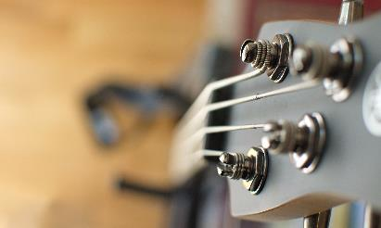


Agenda
Improvements from Feedback
Problem Statement
Project Description
Personas
Minimal Viable Product (MVP)
Architecture
Prototype
Acceptance Criteria & User Stories
Technologies
Algorithms
Sprint Backlogs & Plannings
Retrospective
Teamwork Agreement
GitHub Link
MoodSphere

Slide 3




IMPROVEMENTS FROM FEEDBACK + changes
Algorithms were added.
Teamwork agreement was documented.
The technologies used in the project are well explained.
Team roles and responsibilities were updated.
Minimum Viable Product (MVP) was added.
WEDNESDAY, MARCH 13TH, 2024​

Slide 4
Problem statement
Conventional music streaming services frequently rely on general recommendation algorithms that ignore emotional relevance, which leaves users' emotional demands unmet. The Emotion-Based Music Recommender using Facial Recognition and Convolutional Neural Networks (CNN) project aims to combine state-of-the-art computer vision techniques in order to address this. The system uses CNNs and facial recognition technologies to accurately assess users' facial expressions for emotional indicators. The goal of this integration of sophisticated machine learning algorithms with visual data is to provide consumers with individualized music recommendations that are in line with their current emotional states, improving their listening experience as a whole.
WEDNESDAY, MARCH 13TH, 2024​

Slide 5
Project Description
Unlike traditional music recommenders that often rely on static factors like genres and artists, this project goes a step further by dynamically adjusting recommendations based on the user's current emotional state.
The goal is to curate playlists that resonate with the user's feelings at a given moment, creating a more engaging and relevant music experience. Using emotion analysis techniques, this project determines the user's present emotional state and suggests music that reflects those feelings. The goal of this user-centric strategy is to produce a more engaging and customized music recommendation experience.
WEDNESDAY, MARCH 13TH, 2024​

Slide 6


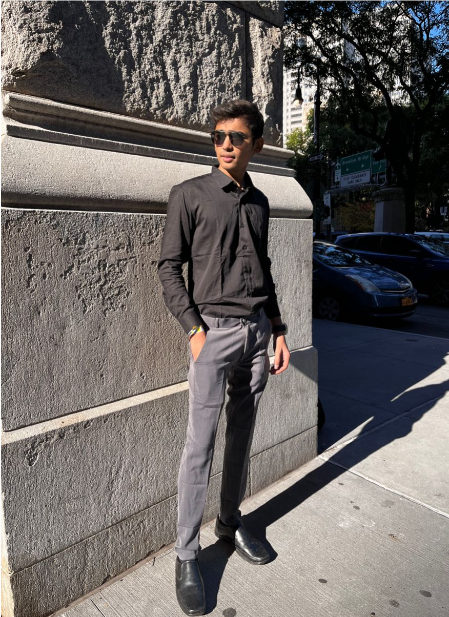

team
Bhavik Chopra
Dhyey Dave
Krushil Sheladiya
Mahesh Nakka
Data Scientist
Developer
Developer
QA Tester/Machine Learning Engineer

Slide 7



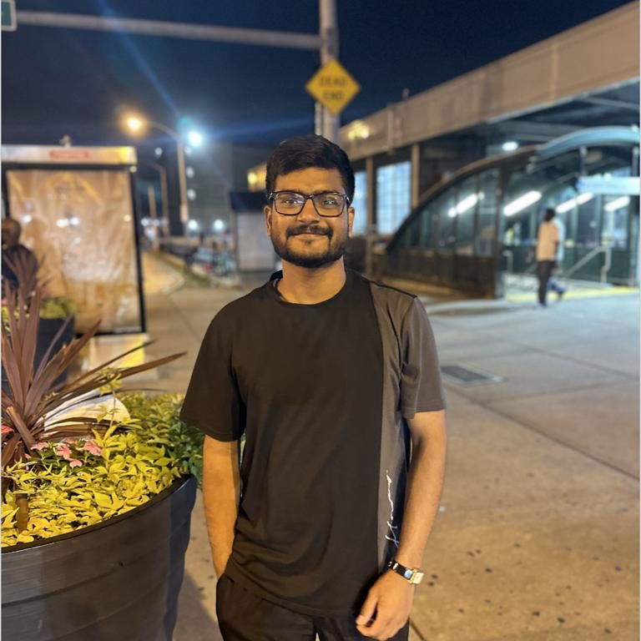
team
Nisarg Bhuva
Shane Parmar
Urmil Trivedi
Vijay Devkate
Scrum Master/Developer
Product Owner/Developer
Developer
Machine Learning Engineer

Slide 8


personas

Slide 9

Background:
Sarah is a 32-year-old marketing executive who works long hours and travels frequently. She often experiences stress due to her demanding job.
Emotional Profile:
Sarah seeks music as a means of unwinding and finding solace after a hectic workday. She values tracks that induce a sense of calmness and relaxation.
Sarah:
The Busy Professional
Preferred Genres:
Instrumental tracks, Jazz for its soothing melodies, Ambient music for background ambiance, and Calm Pop for its easy-listening qualities.
MoodSphere

Slide 10

Background:
Alex is a 27-year-old fitness trainer who is passionate about leading an active lifestyle. He regularly engages in high-intensity workouts to maintain his physical health.
Emotional Profile:
For Alex, music serves as a motivational tool during workouts. He looks for energetic beats and rhythmic tunes that can enhance his performance and keep his energy levels high.
Alex:
The Energetic Fitness Enthusiast
Preferred Genres:
Alex leans towards EDM with upbeat tempos, Hip-Hop for its rhythmic flow, Rock for its adrenaline-pumping vibe, and Upbeat Pop for its lively tunes.
MoodSphere

Slide 11

Background:
Mia is a 20-year-old college student majoring in philosophy. She values moments of introspection and often immerses herself in thoughtful activities like reading and studying.
Emotional Profile:
Music is an integral part of Mia's study routine, and she looks for tracks that complement her moods. She prefers music that fosters focus and a calming ambiance.
Mia:
The Reflective College Student
Preferred Genres:
Indie music for its authenticity, Alternative tunes for a diverse sound, Acoustic tracks for their simplicity, and Chill Electronica for a relaxing background.
MoodSphere

Slide 12

Background:
Oliver is a 35-year-old artisan who spends his days crafting unique handmade items. His work requires precision and creativity, and he often seeks inspiration through various artistic outlets.
Emotional Profile:
Oliver values music that fuels his creative process. He looks for tracks with eclectic and innovative sounds that inspire his artistic imagination and enhance his focus.
Oliver:
The Busy Professional
Preferred Genres:
Ambient Electronic for its atmospheric sounds, Indie Experimental for its creative diversity, Classical for its timeless inspiration.
MoodSphere

Slide 13
MINIMAL VIABLE PRODUCT(MVP)
MoodSphere

Slide 14
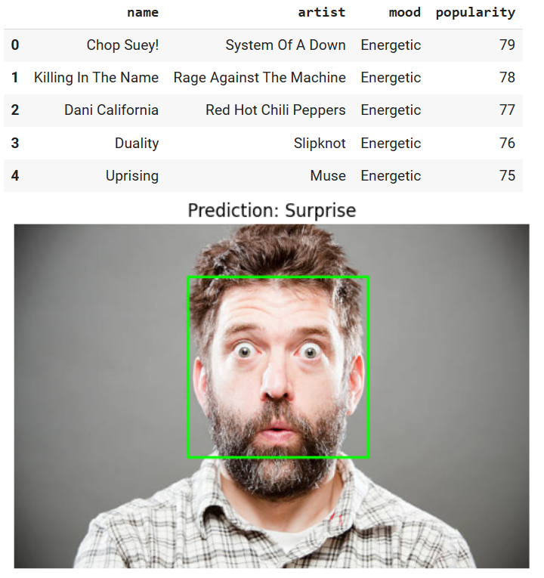
MoodSphere

Slide 15
Code Snippets
MoodSphere

Slide 16
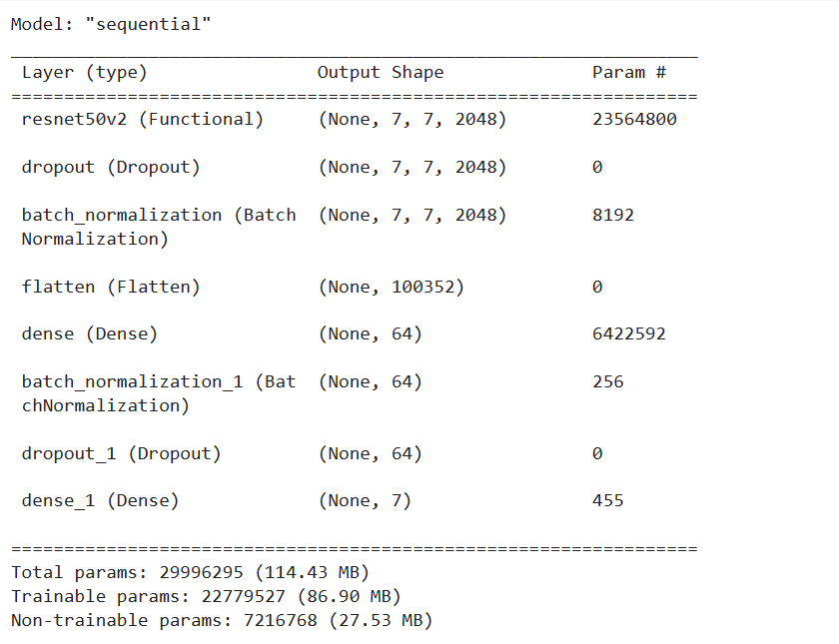
MoodSphere

Slide 17
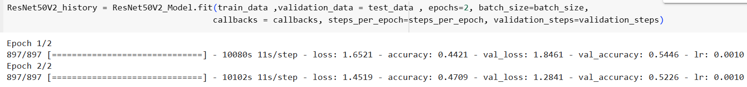
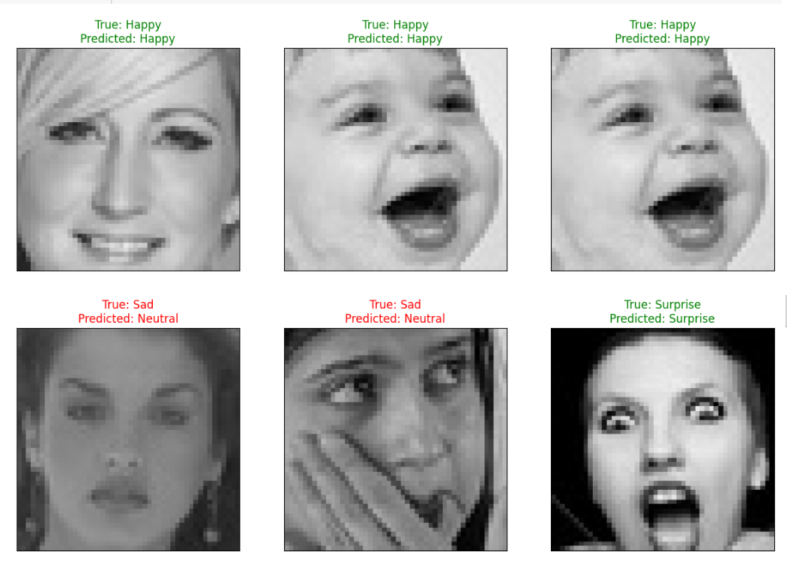
MoodSphere

Slide 18
Architecture Diagram

Slide 19
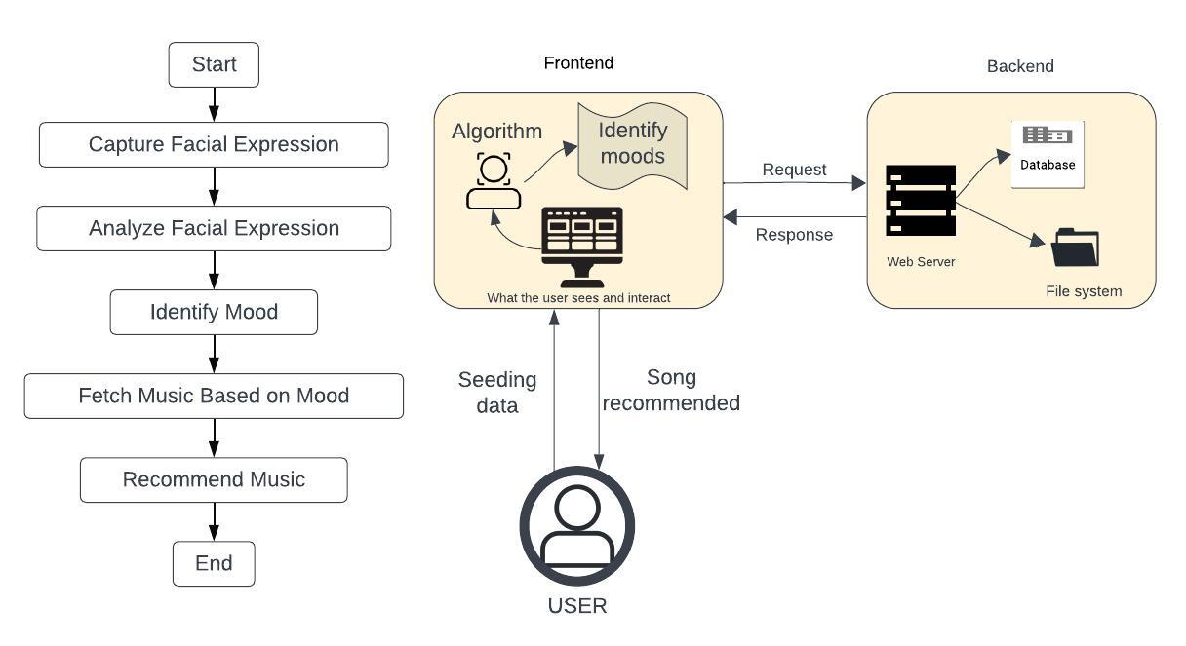
Architecture

Slide 20
PROTOTYPE

Slide 21
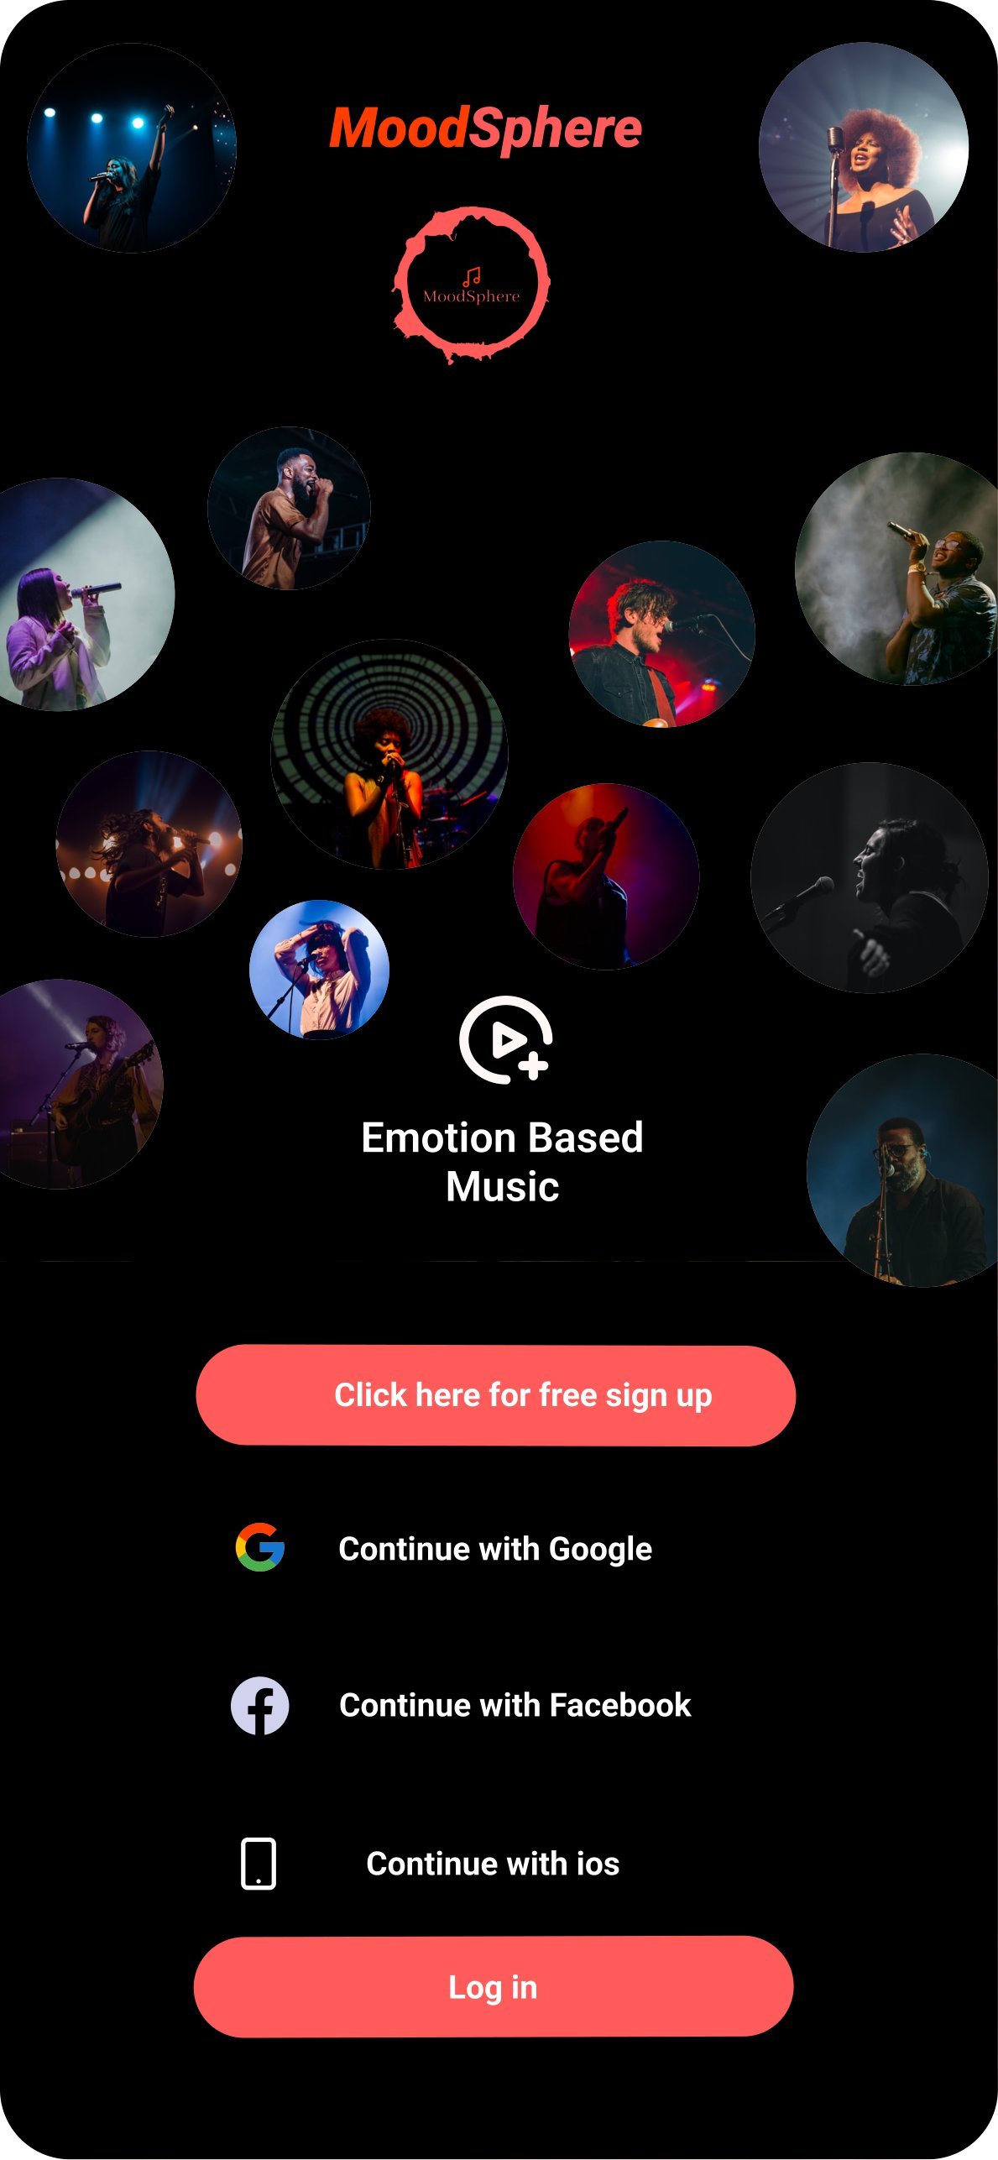
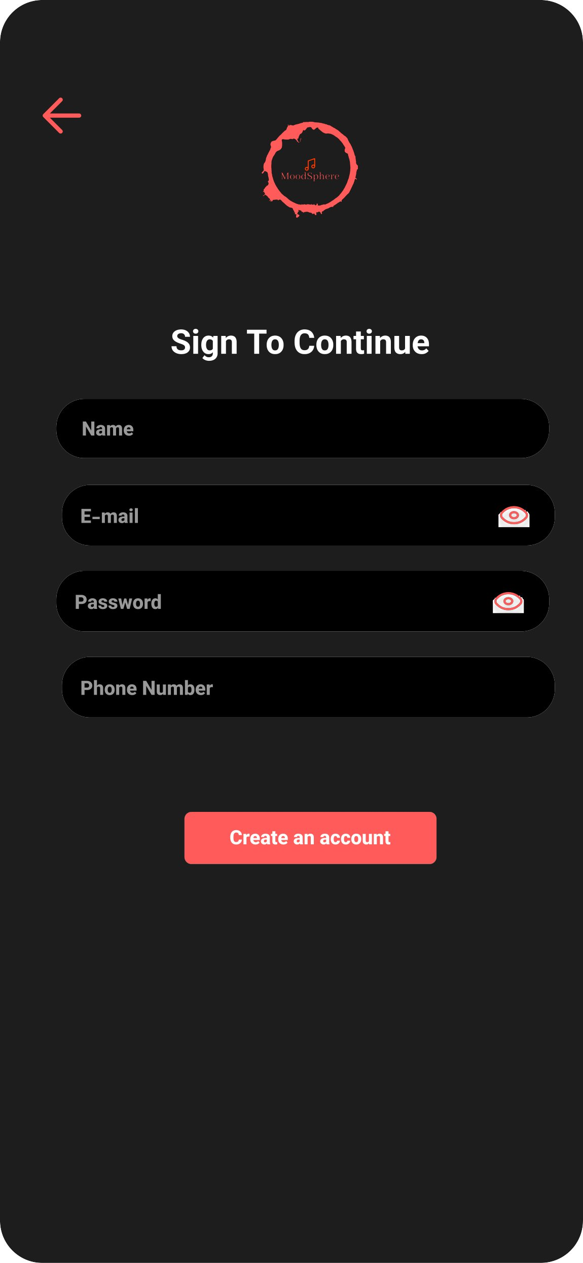
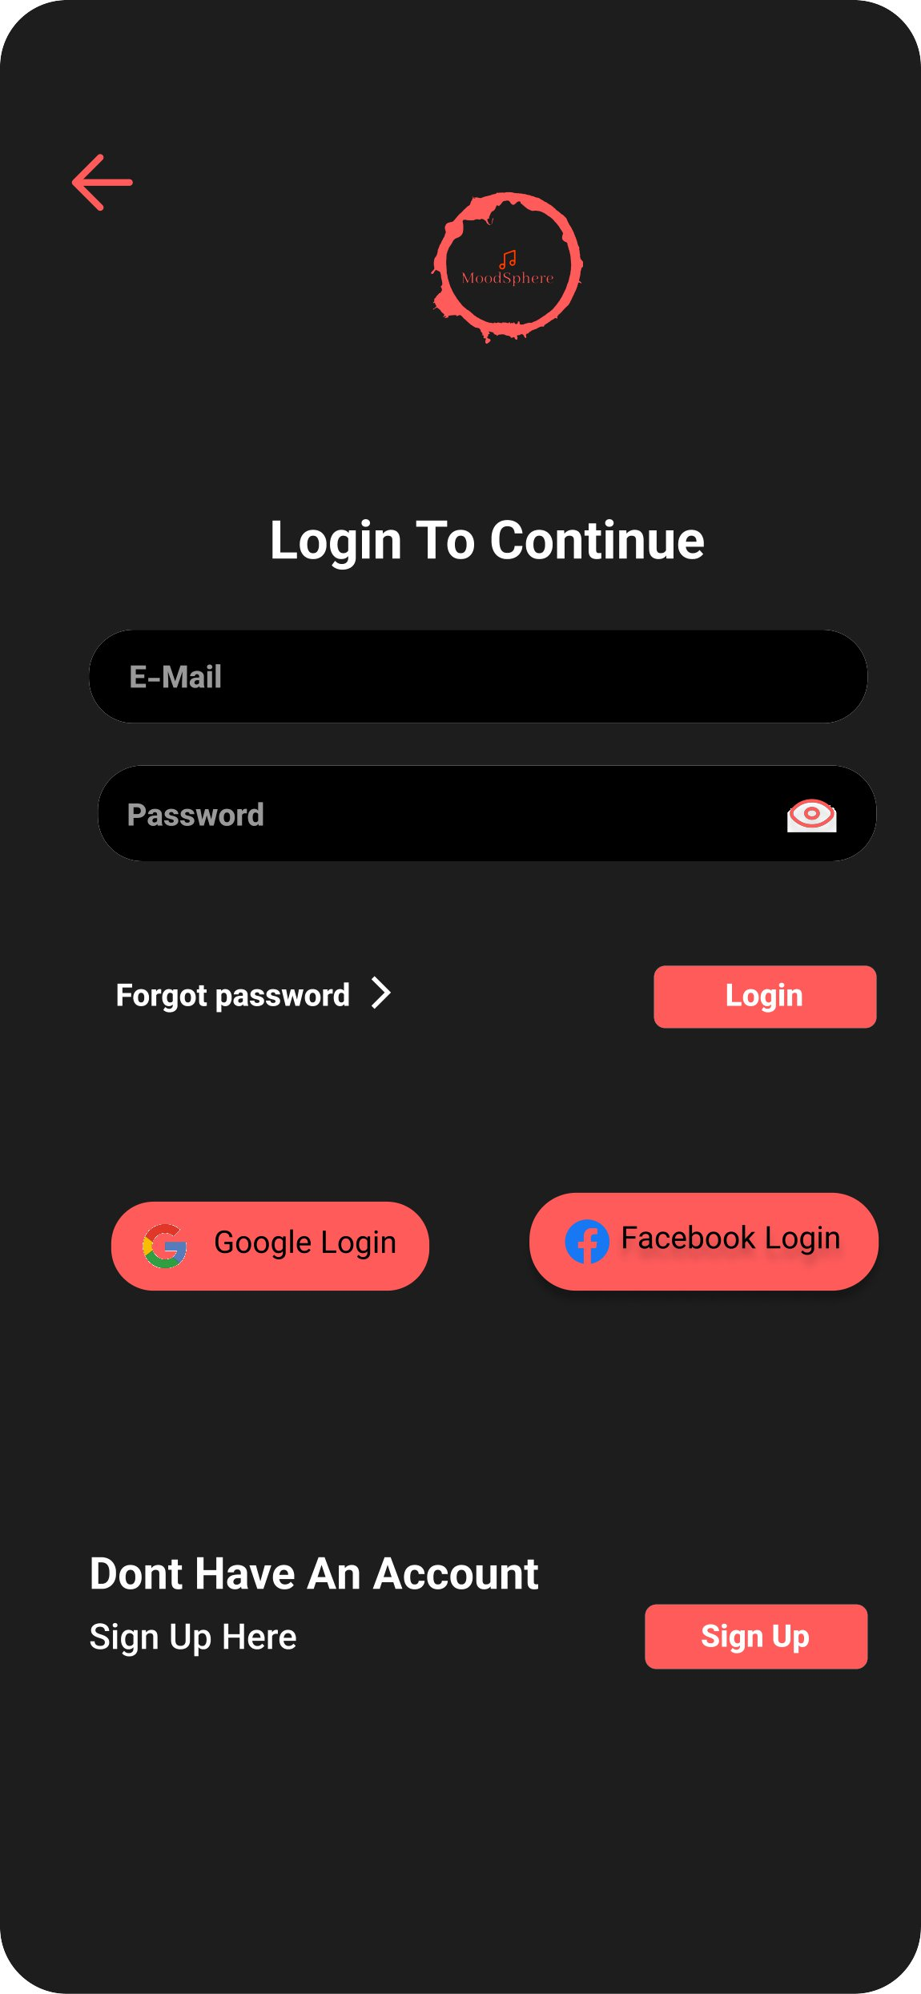
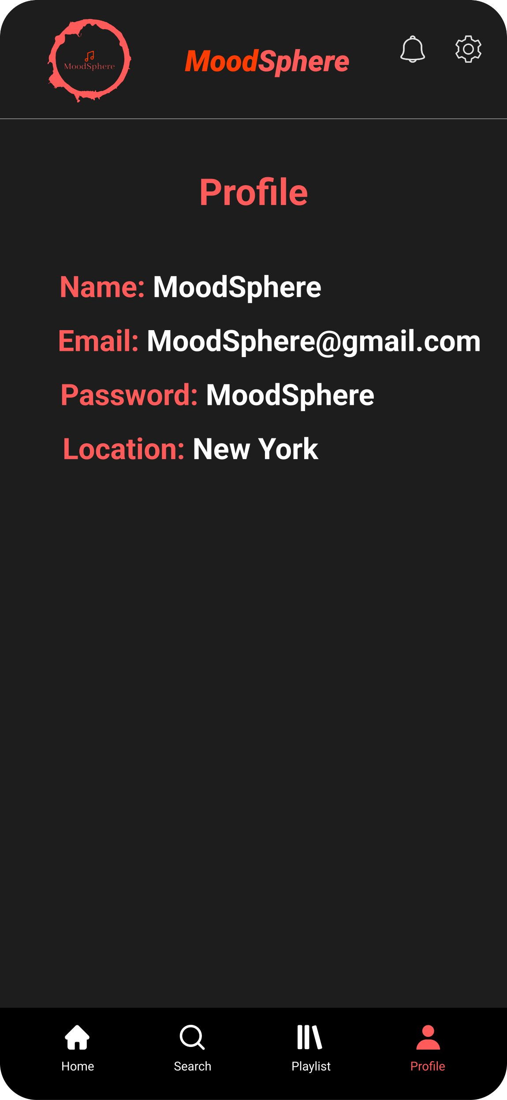
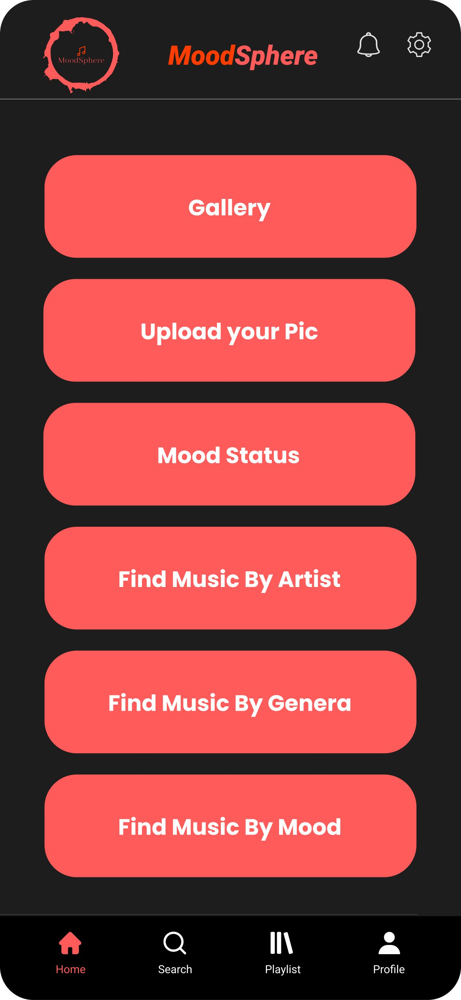
Prototype
MoodSphere

Slide 22
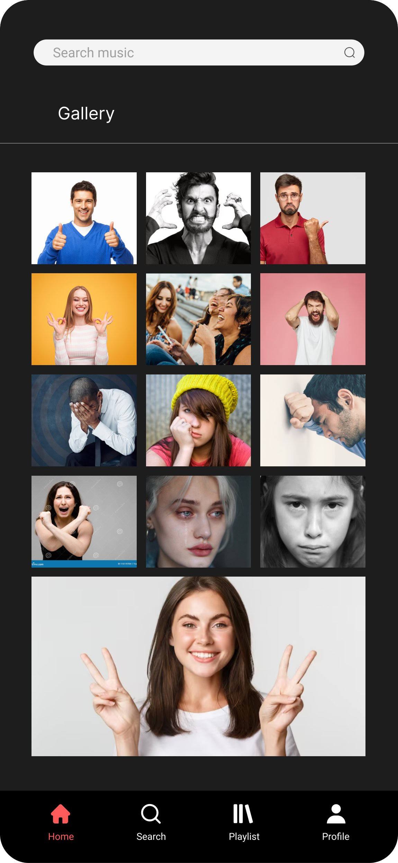
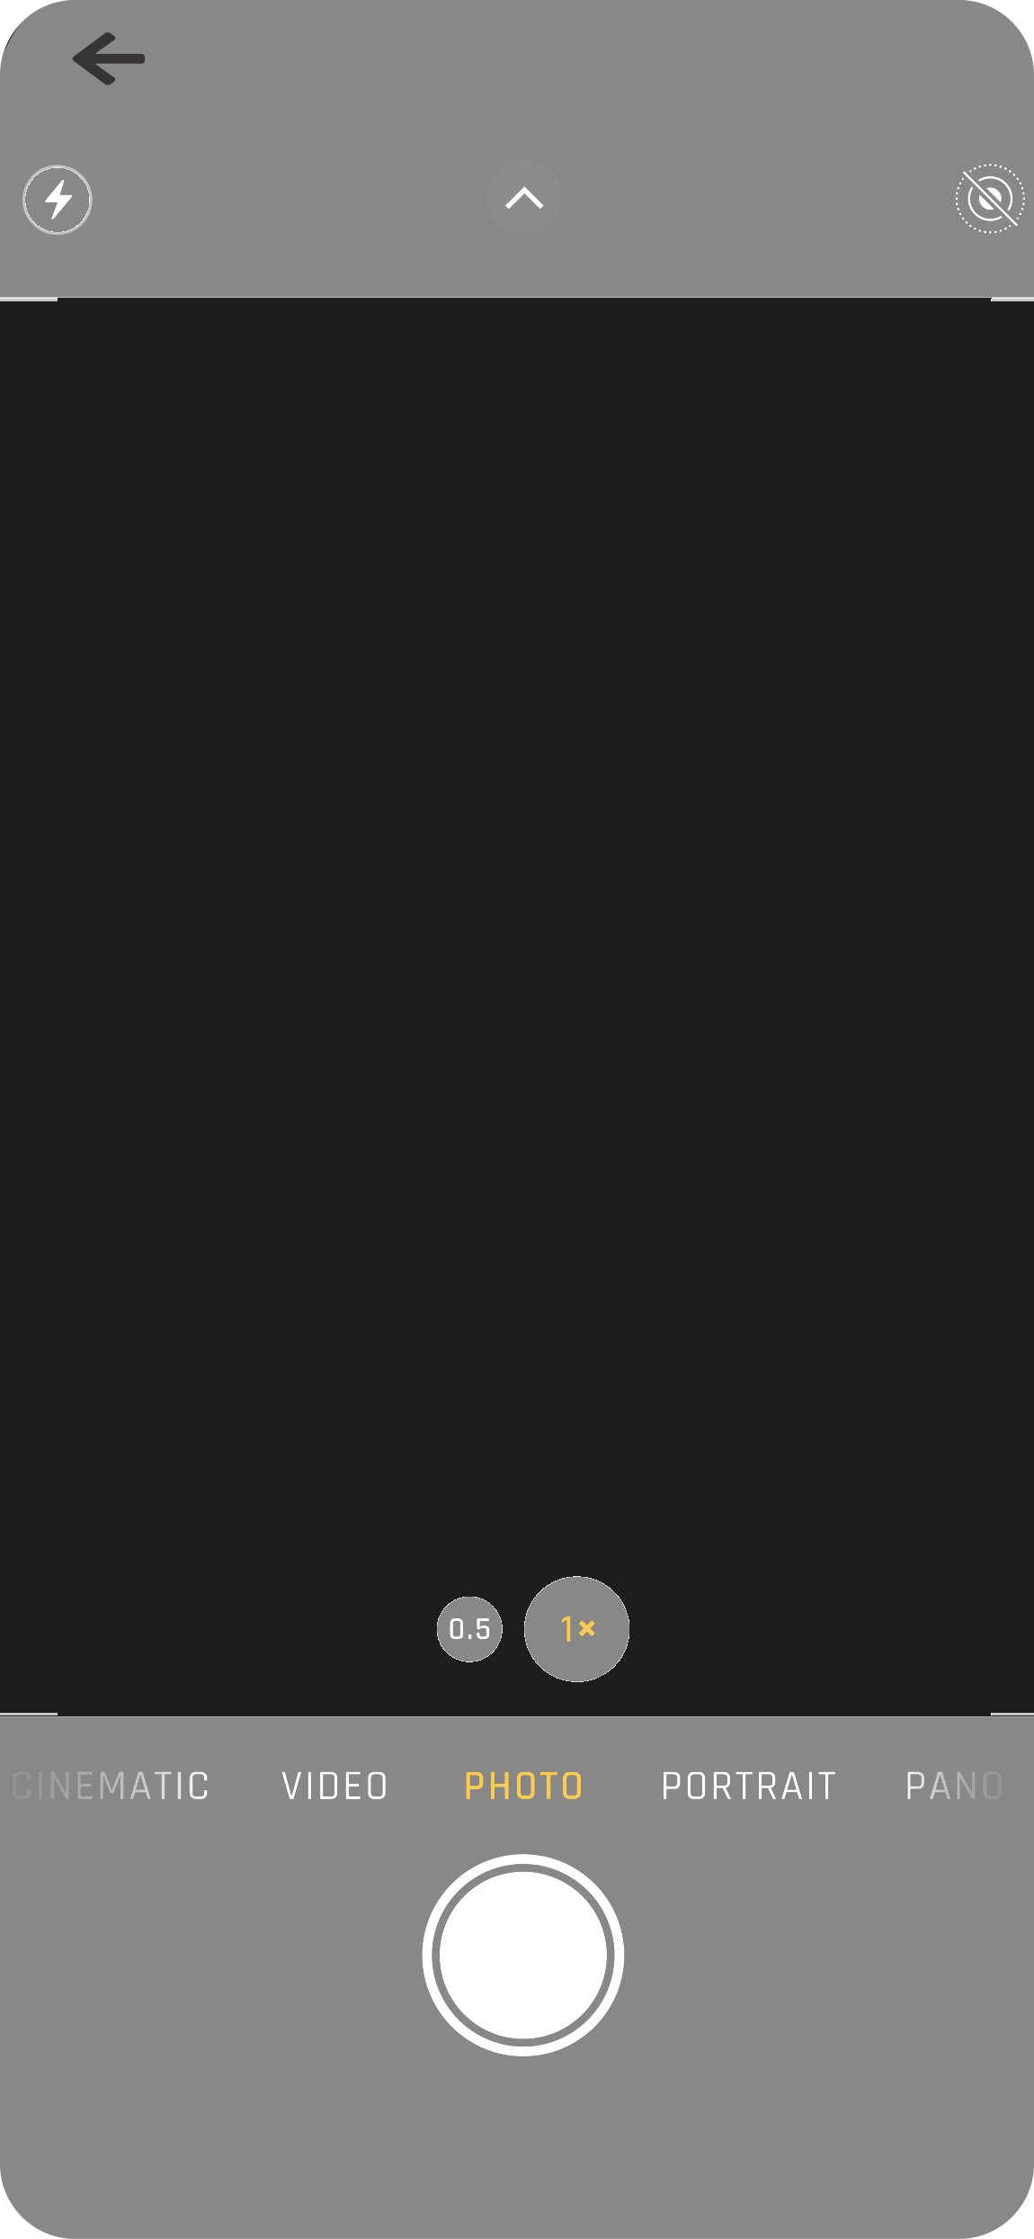
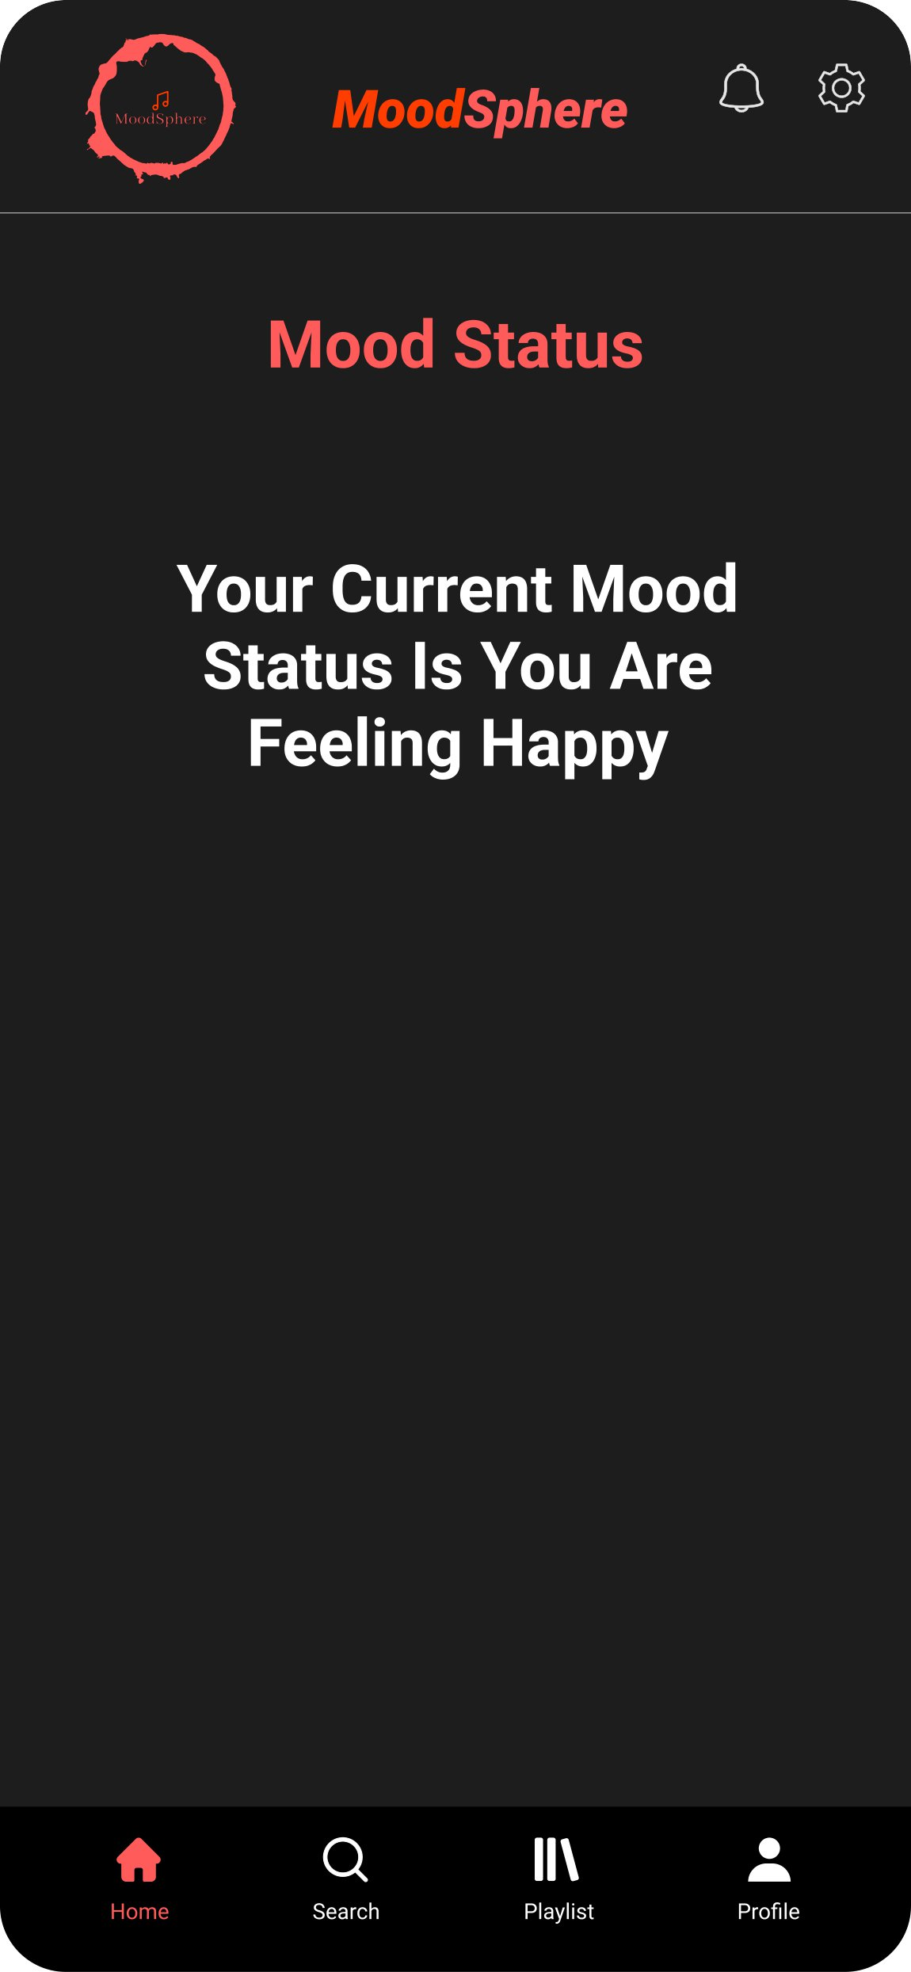
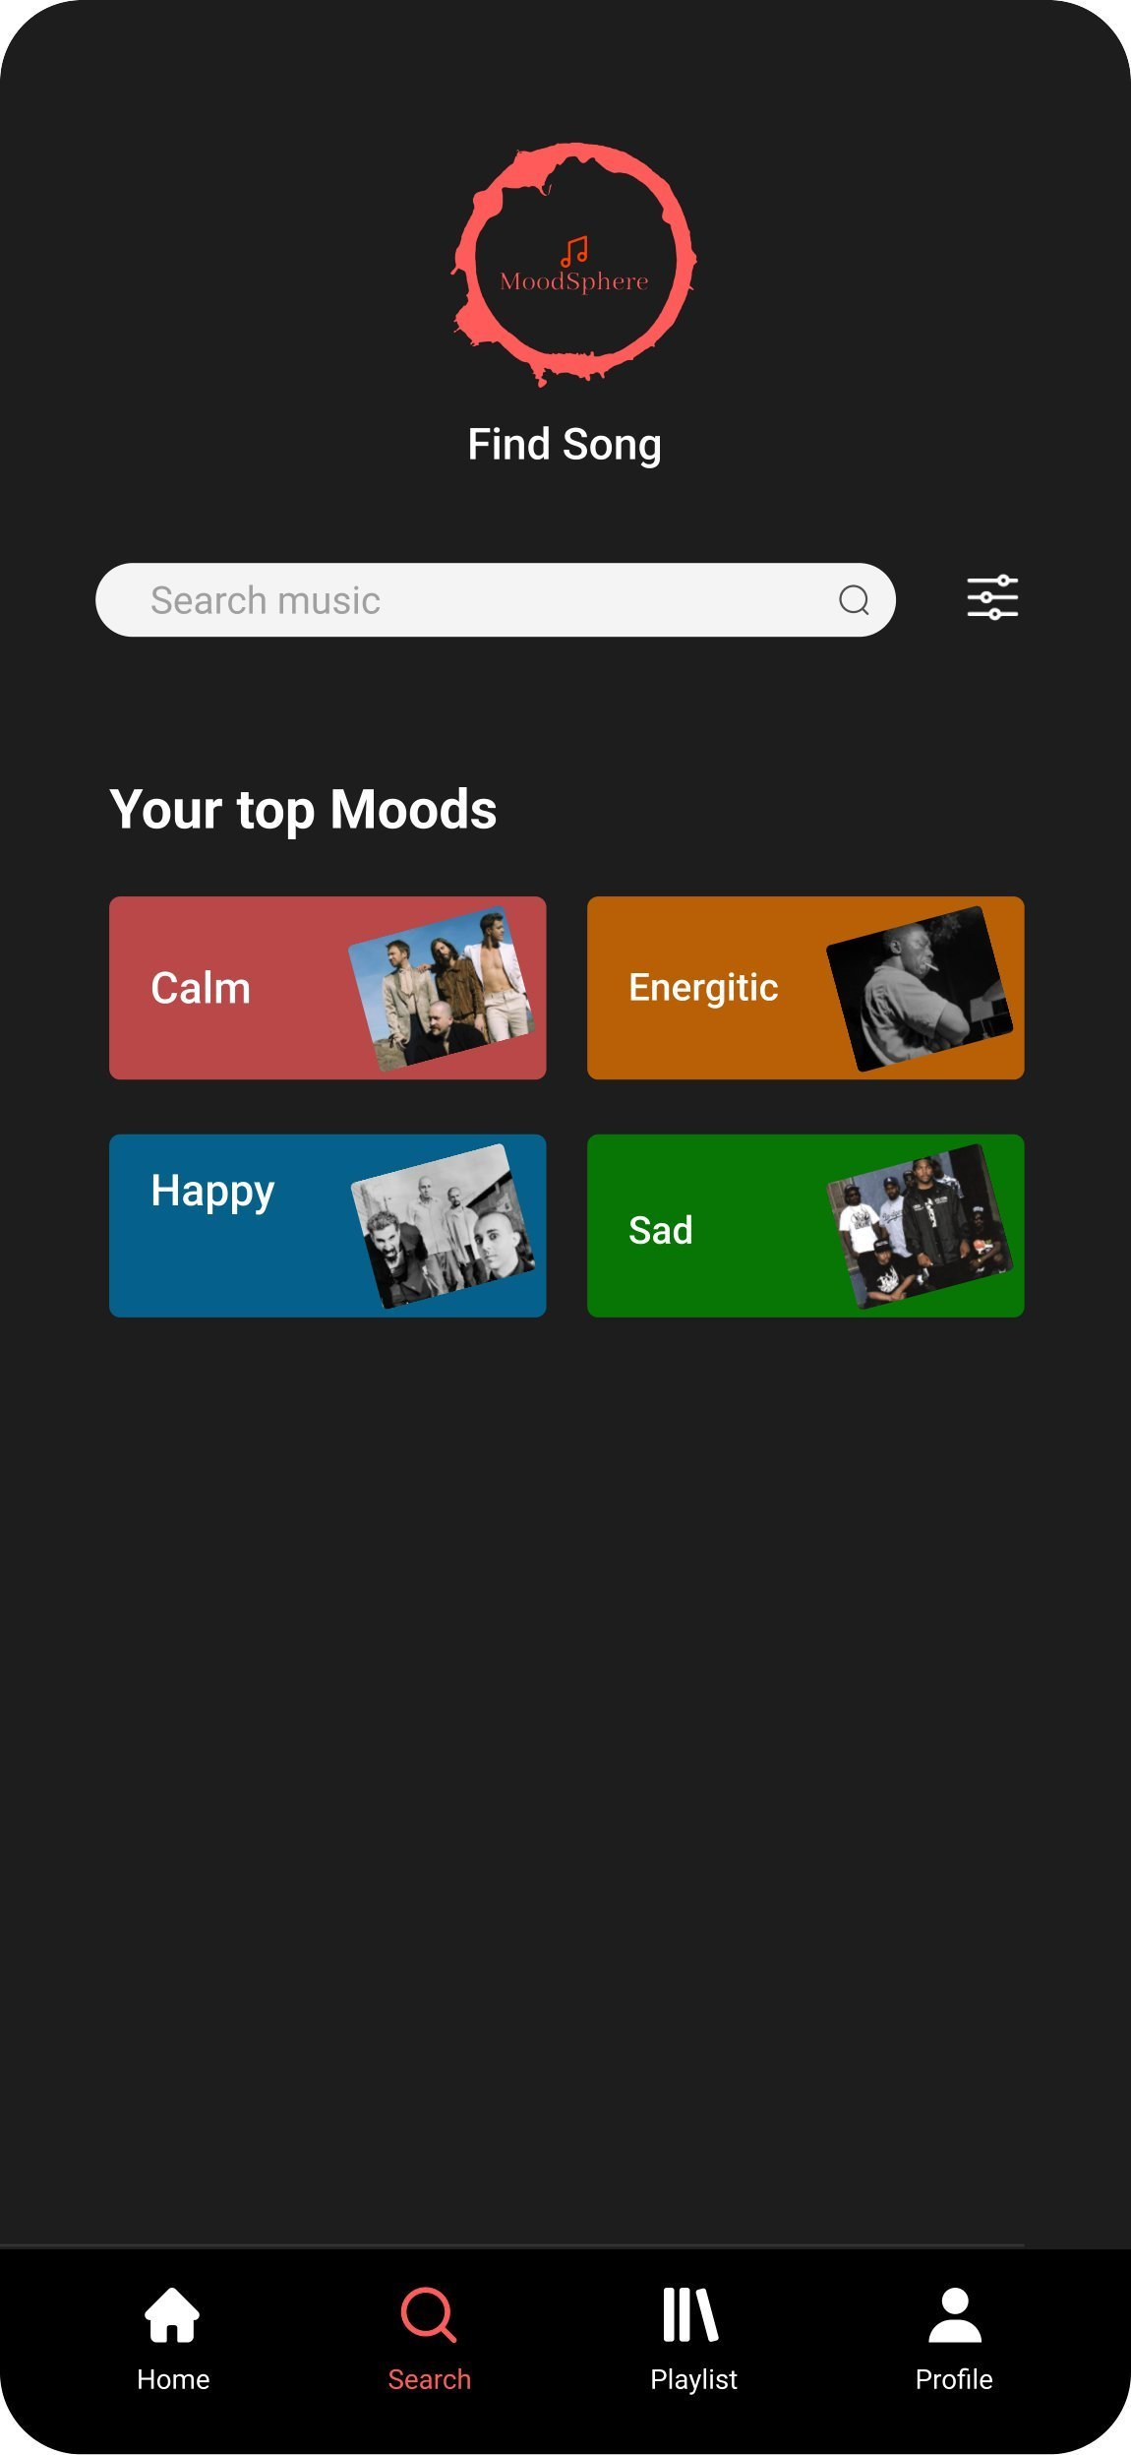
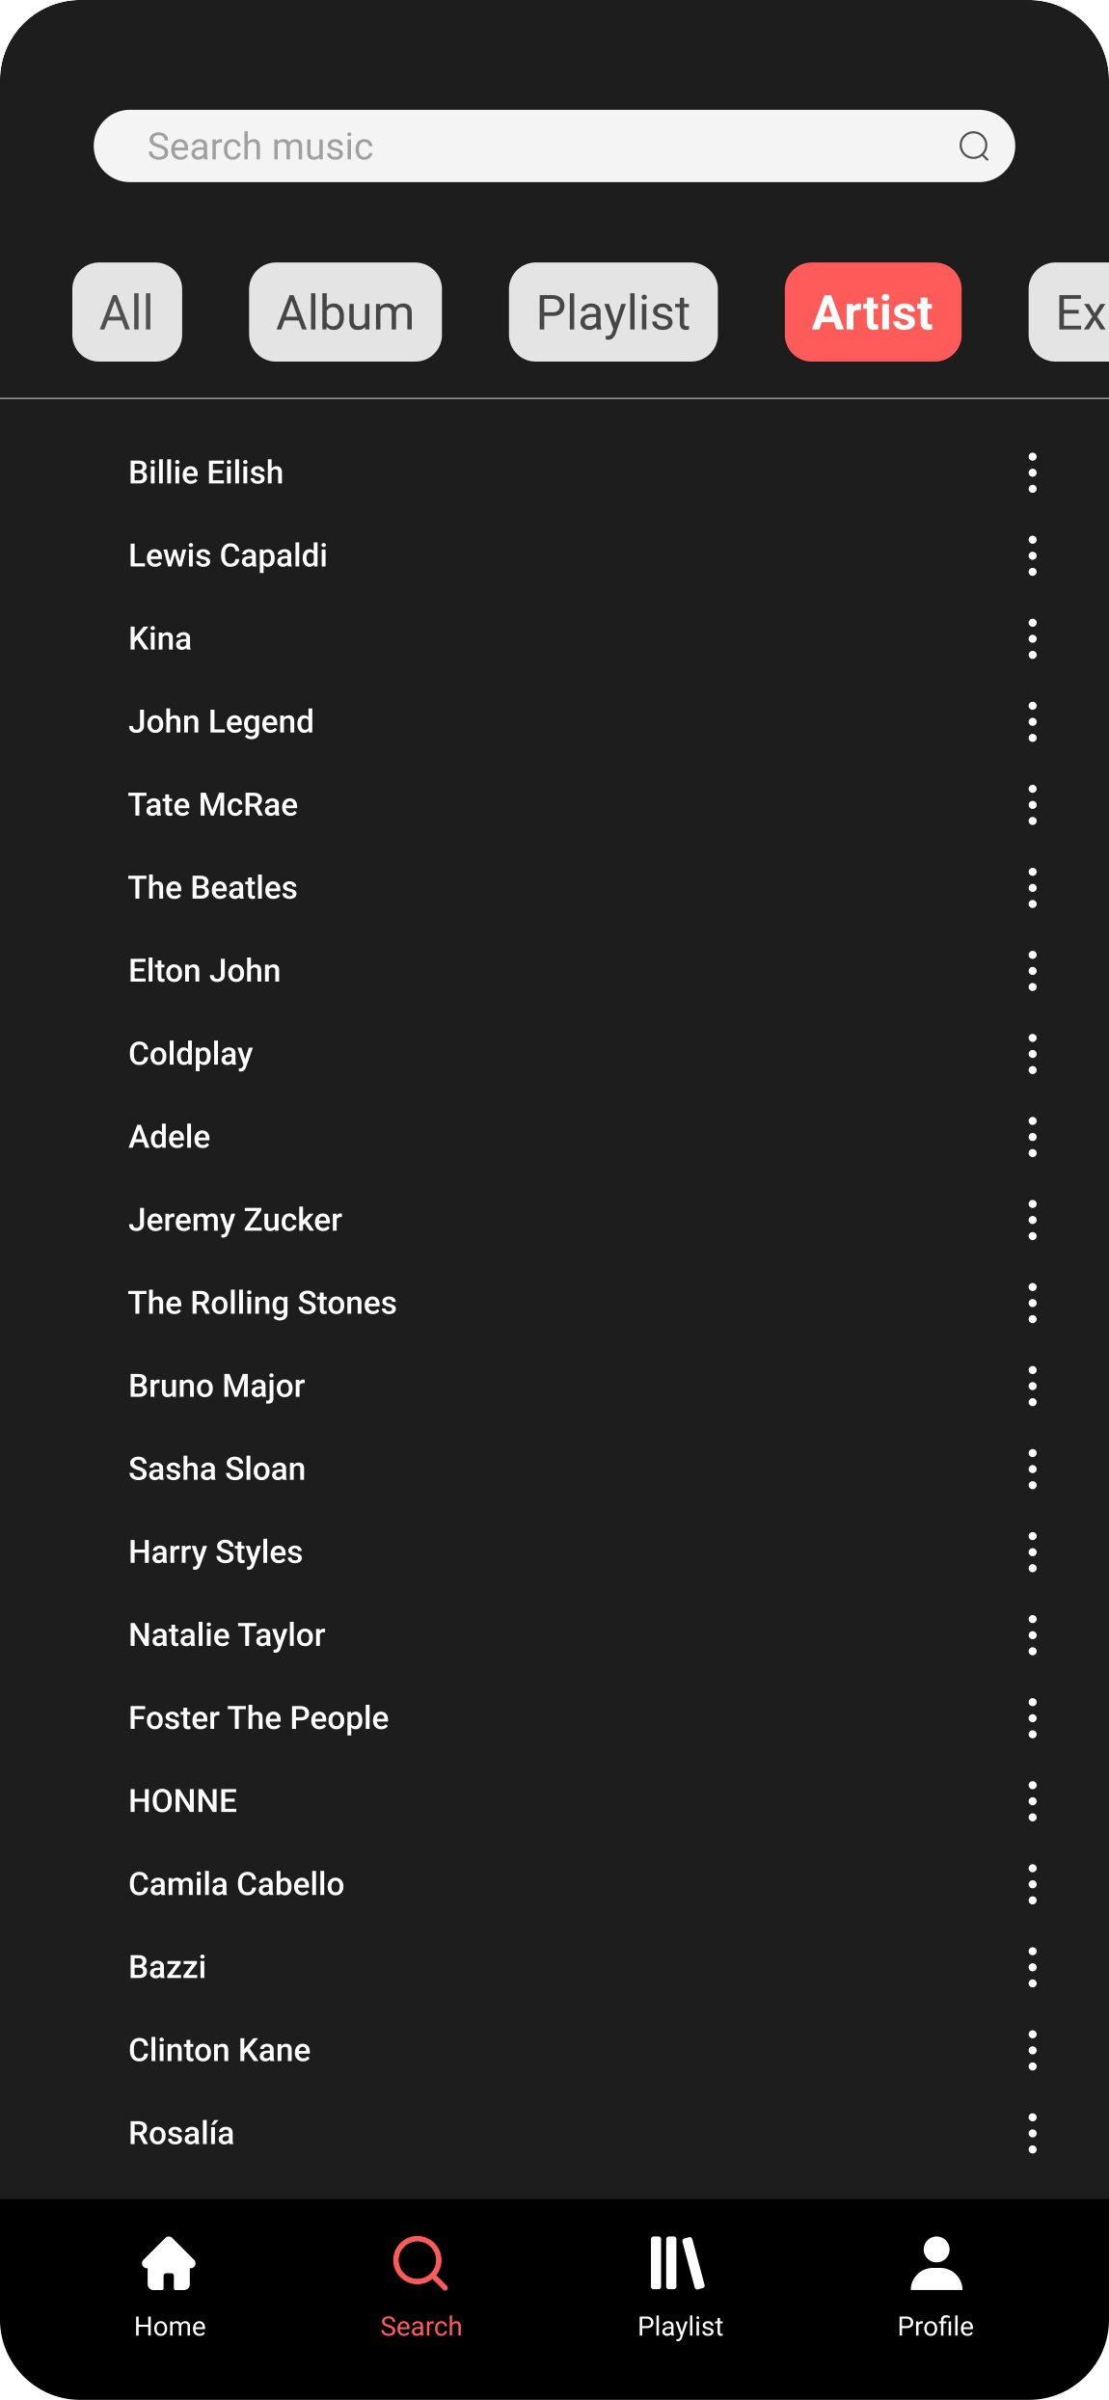
Prototype
MoodSphere

Slide 23
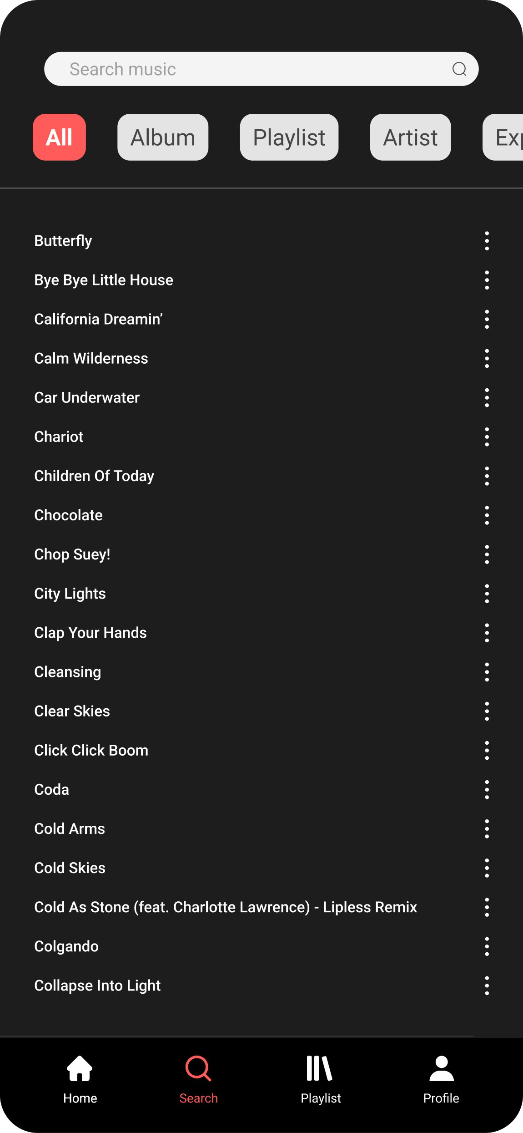
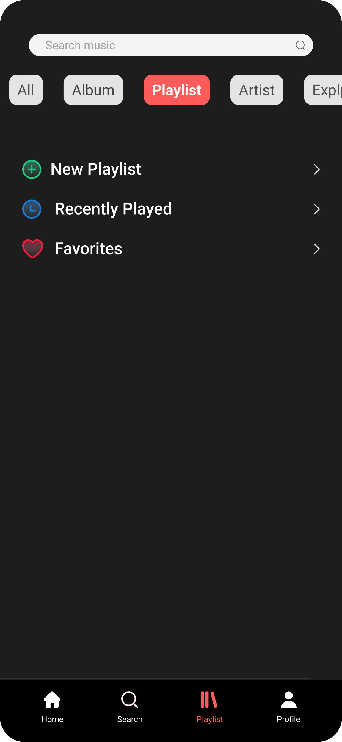
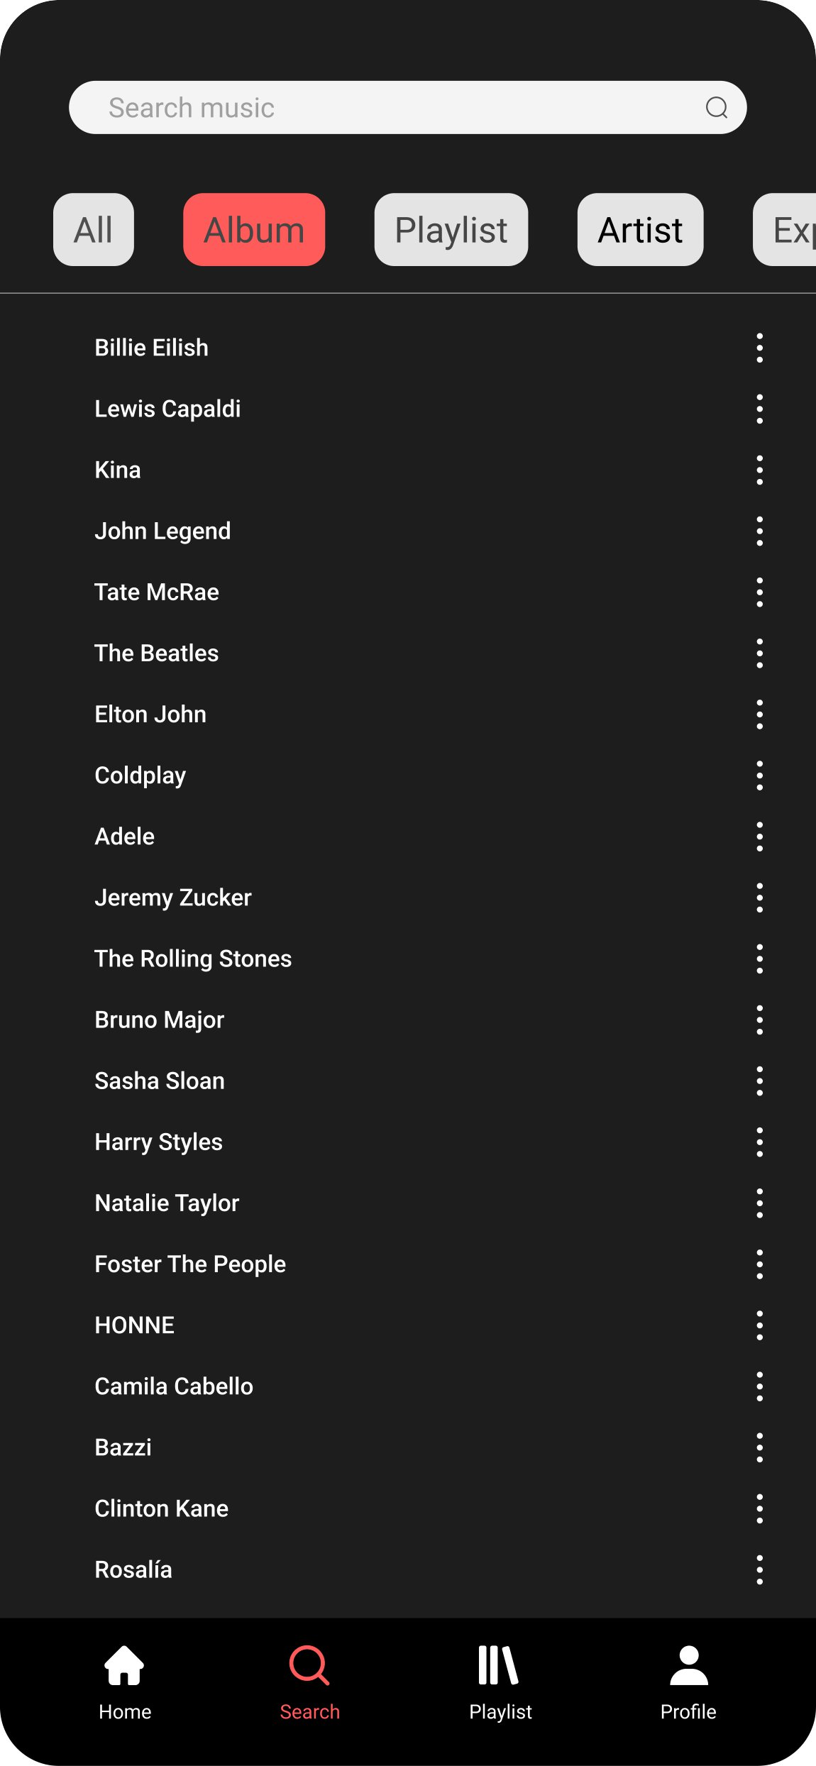
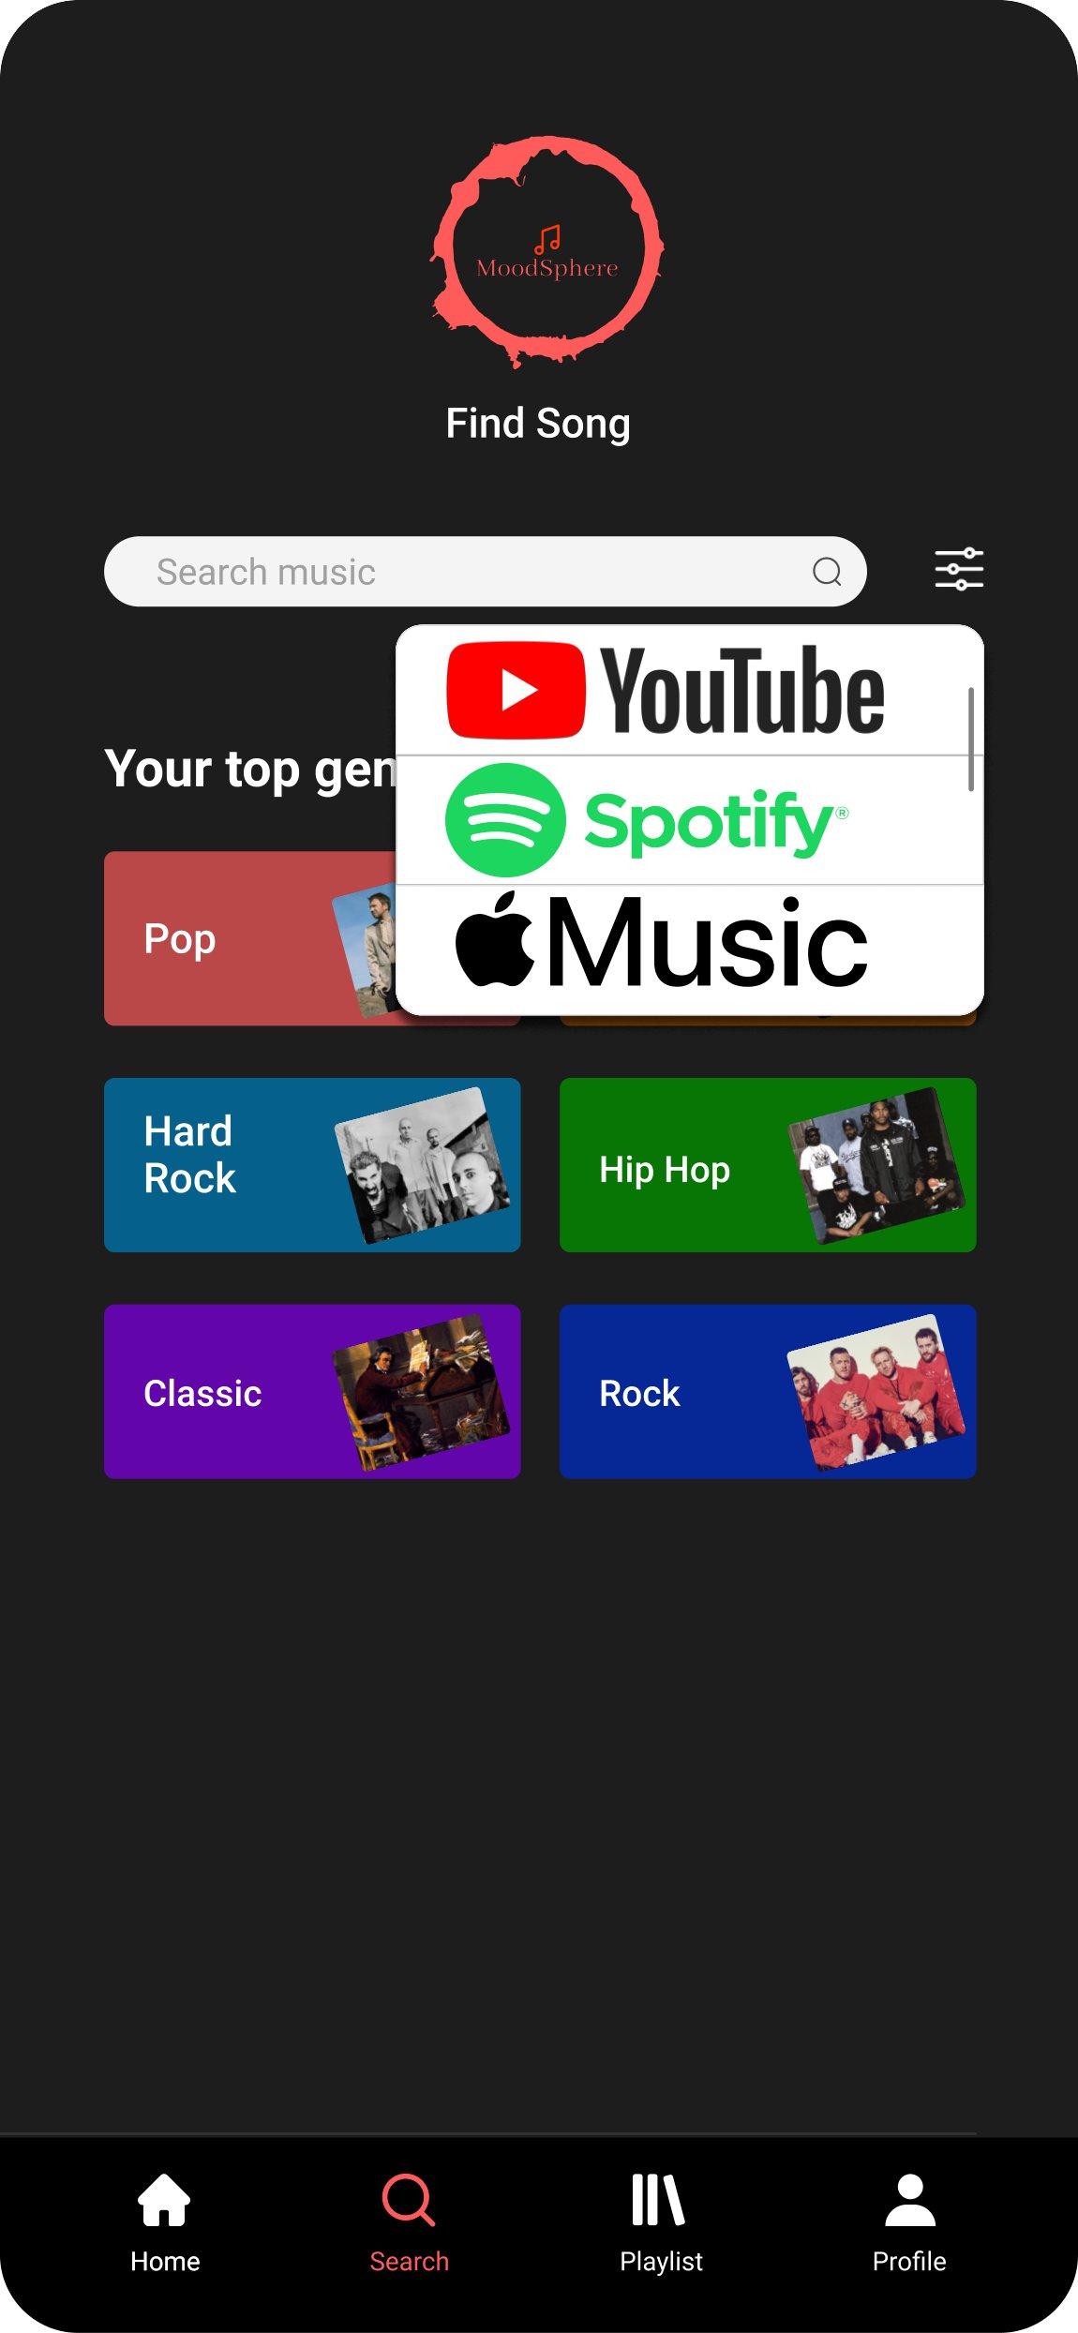
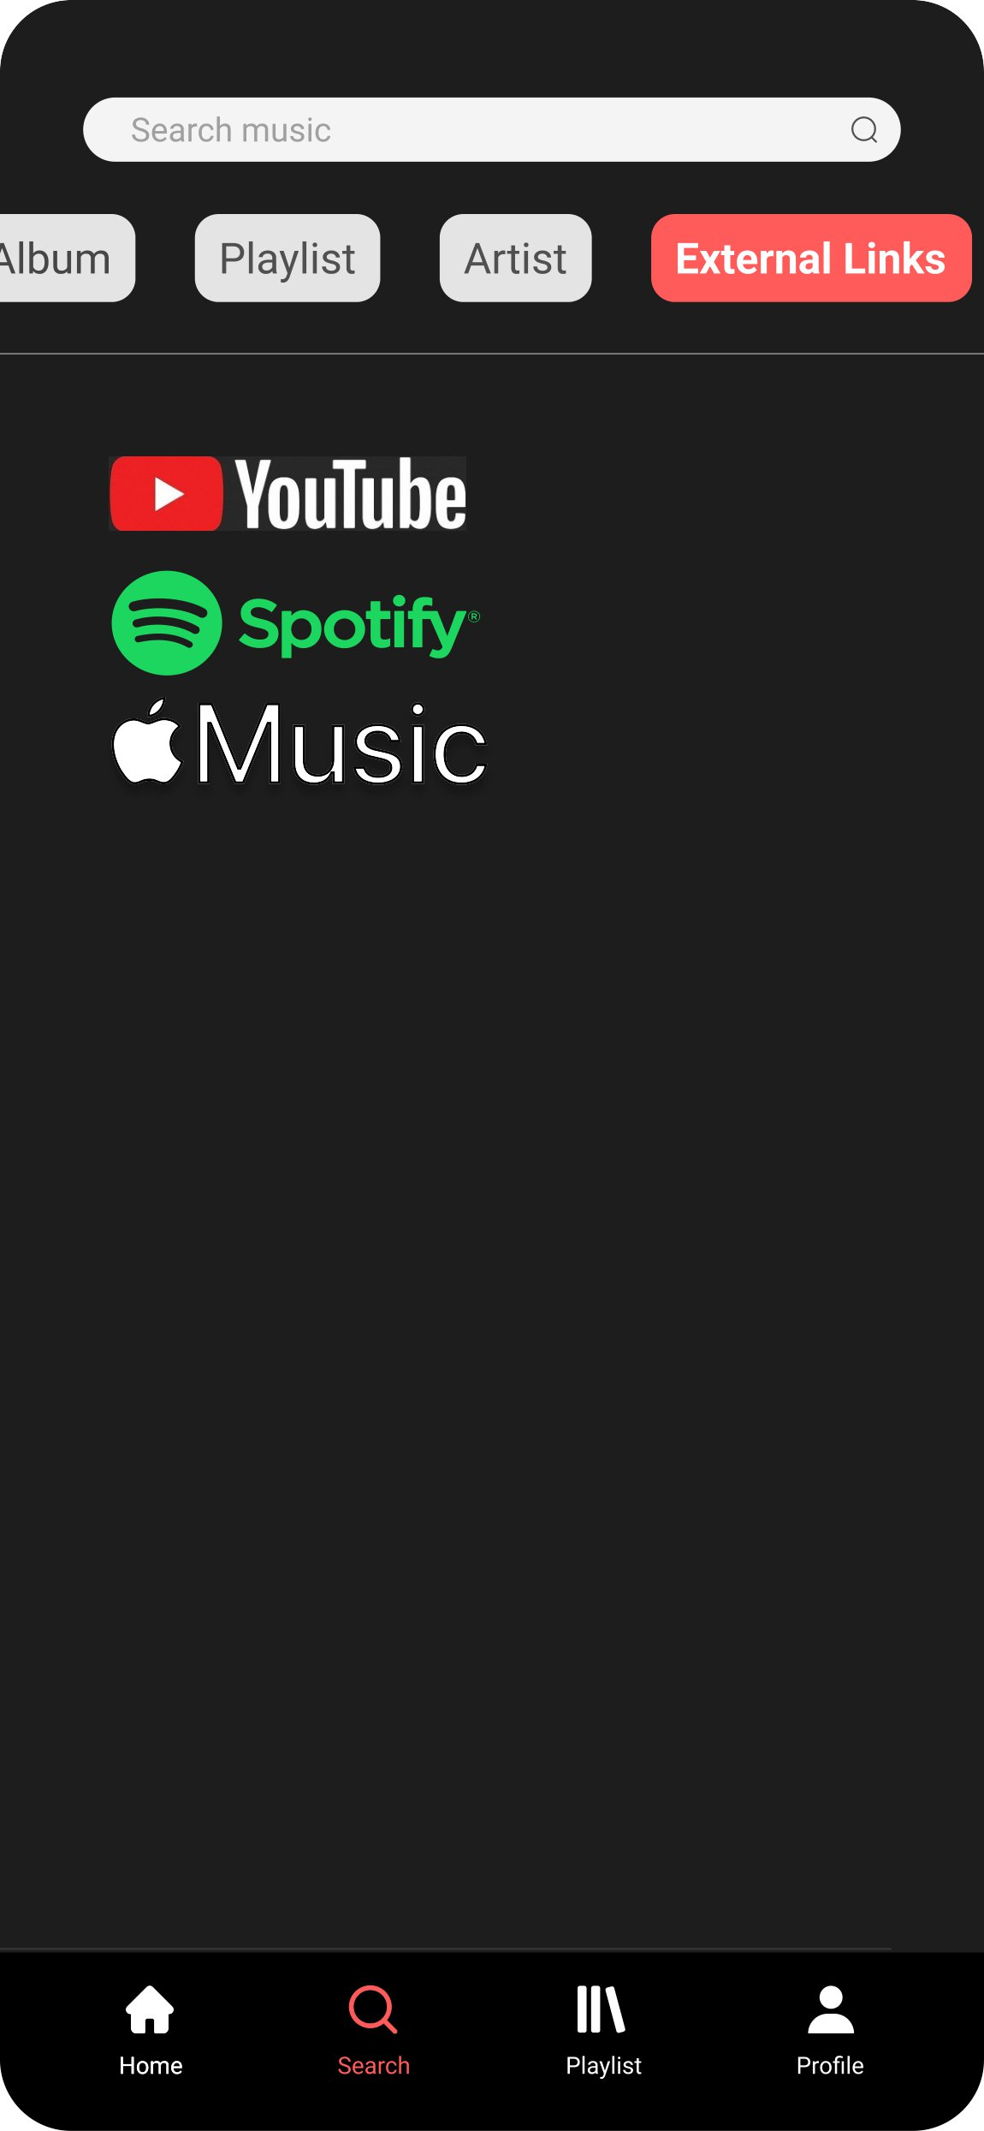
Prototype
MoodSphere

Slide 24
User Stories, Acceptance Criteria And Test Cases

Slide 25
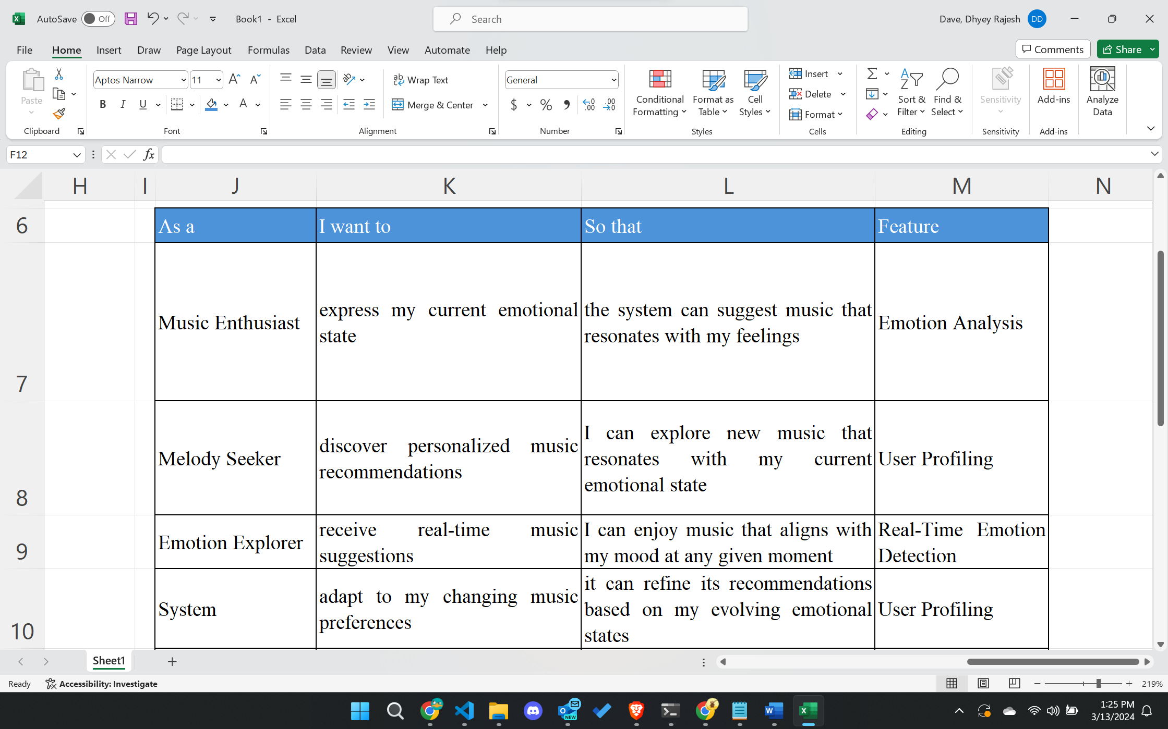
User Stories

Slide 26
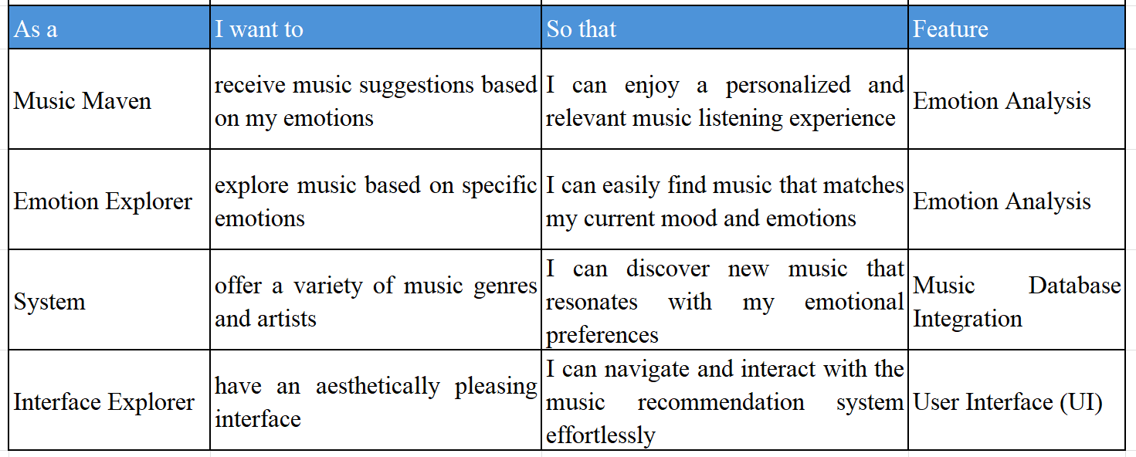
User Stories

Slide 27
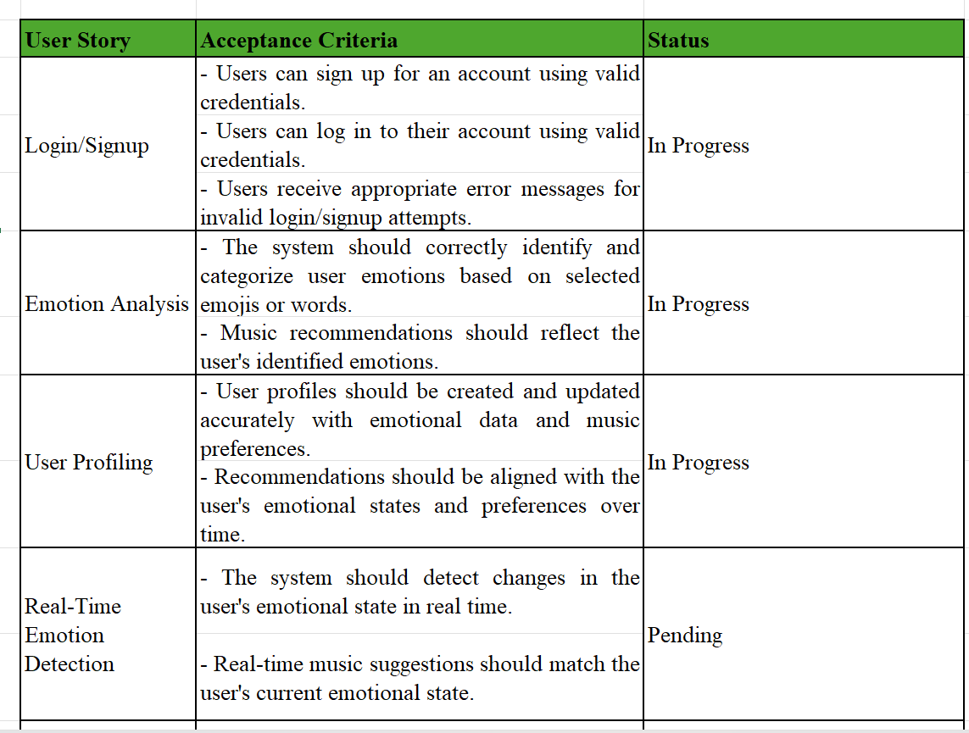
Acceptance Criteria

Slide 28
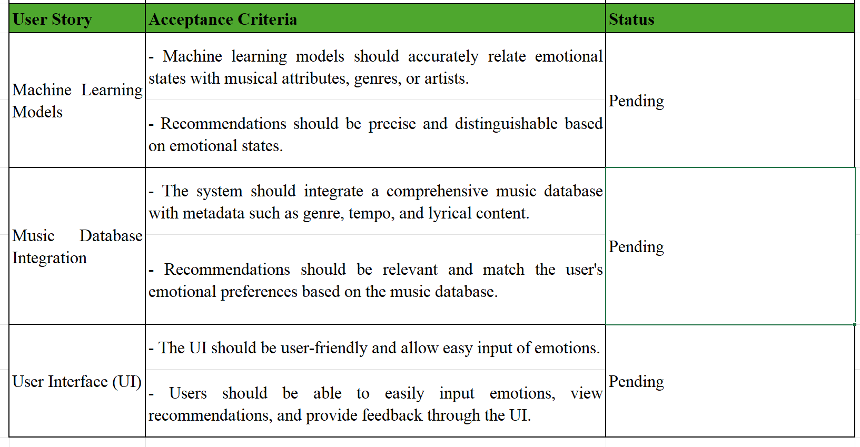
Acceptance Criteria

Slide 29
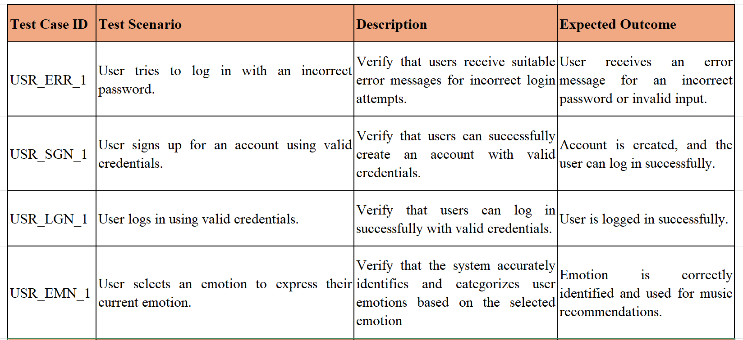
Test Cases

Slide 30
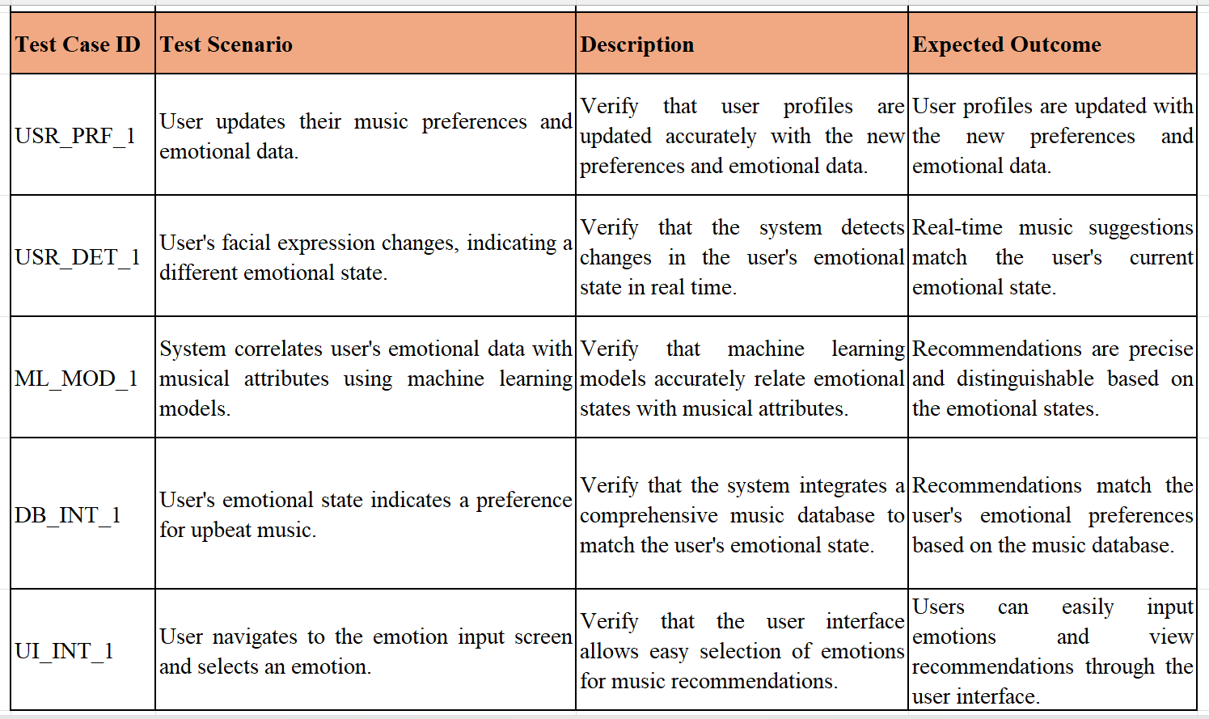
Test Cases

Slide 31
TECHNOLOGIES

Slide 32








Technologies
TensorFlow
React
Firebase
Python
HTML
CSS
Django
Jira

Slide 33
Technologies description
TensorFlow will be the foundation for building the emotion detection engine of our music recommender.
Main applications of using TensorFlow will be Model Development and Real-Time Inference
React serves as the cornerstone for constructing the user interface (UI) of your music recommender app. Main applications of using React will be UI Design and Data Visualization
It is a suite of cloud-based services from Google that simplifies building mobile and web applications by providing features like: Authentication, Database Cloud Functions Hosting Analytics
Python supports OOP principles, allowing you to structure your code using classes and objects. This promotes code reusability, modularity, and maintainability, especially when dealing with complex data structures like user profiles and music recommendations.
MoodSphere

Slide 34
TECHNOLOGIES DESCRIPTION
HTML Defines the structure and content of web pages. Creates the basic building blocks of web pages using elements like headings, paragraphs, lists, images, and forms.
CSS controls the presentation of web pages, applying visual styles like fonts, colors, layout, and animations.
It defines styles that are applied to HTML elements, controlling their appearance.
High-level web framework built in Python, simplifying the development process for building web applications.
Can be employed to create the backend of your application, handling data processing, routing, and interacting with Jira
Project management software specifically designed for agile teams, facilitating task tracking, issue reporting, and collaboration.
MoodSphere

Slide 35
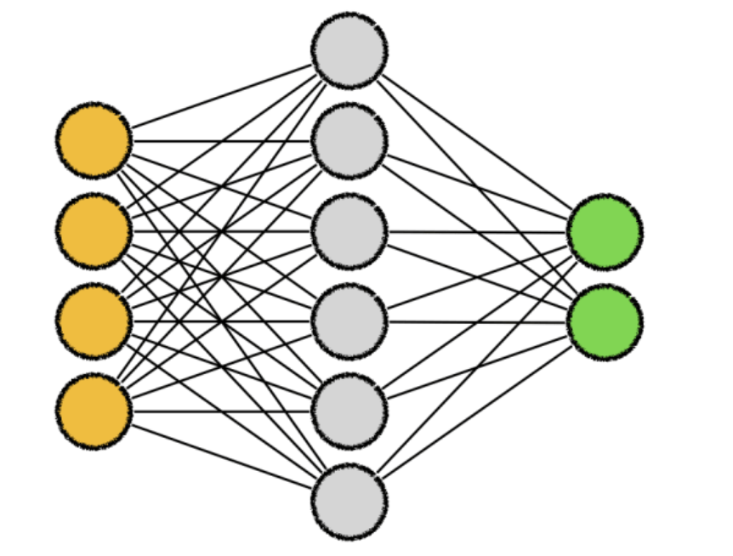

Algorithms
Convolutional neural networks (CNNs) are a form of deep neural network that are frequently used in computer vision tasks like object detection, picture segmentation, and image recognition. When the term "CNN algorithm" is used, it usually refers to CNNs.
ResNet-50 is a deep convolutional neural network with 50 layers, renowned for its use of residual connections that aid in training very deep networks. Because of its outstanding performance in tasks like object identification, picture segmentation, and image classification, it has been frequently used in computer vision applications.
MoodSphere

Slide 36

Algorithms
Keras is a popular Python framework that makes neural network construction and training simple and straightforward. It provides an elevated interface to deep learning frameworks like as TensorFlow and Theano, facilitating swift model deployment and development.
MoodSphere

Slide 37
SPRINT BACKLOG

Slide 38
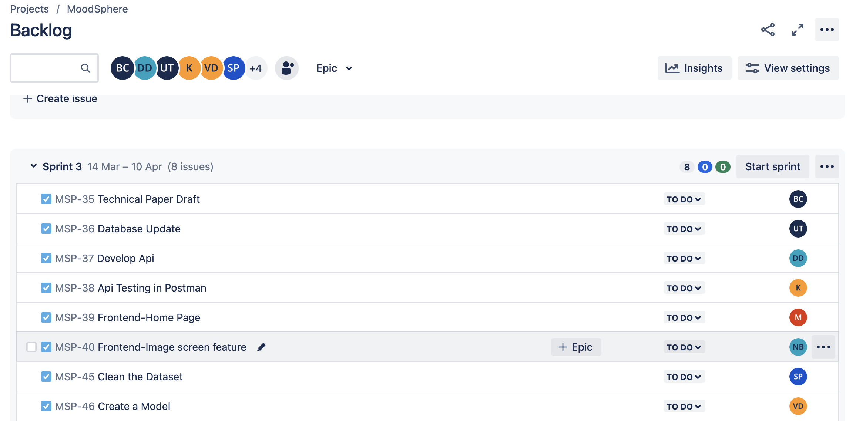
Sprint 3
MoodSphere

Slide 39
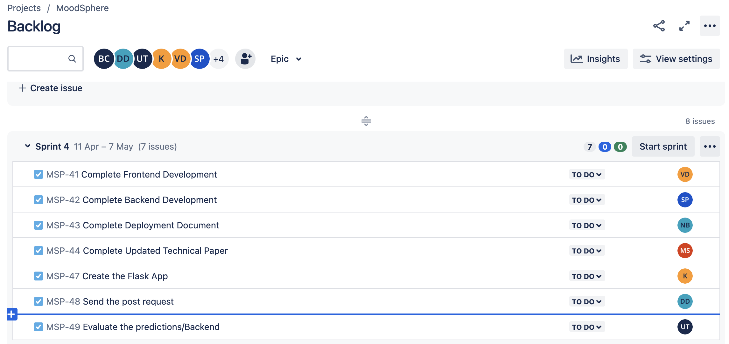
Sprint 4
MoodSphere

Slide 40
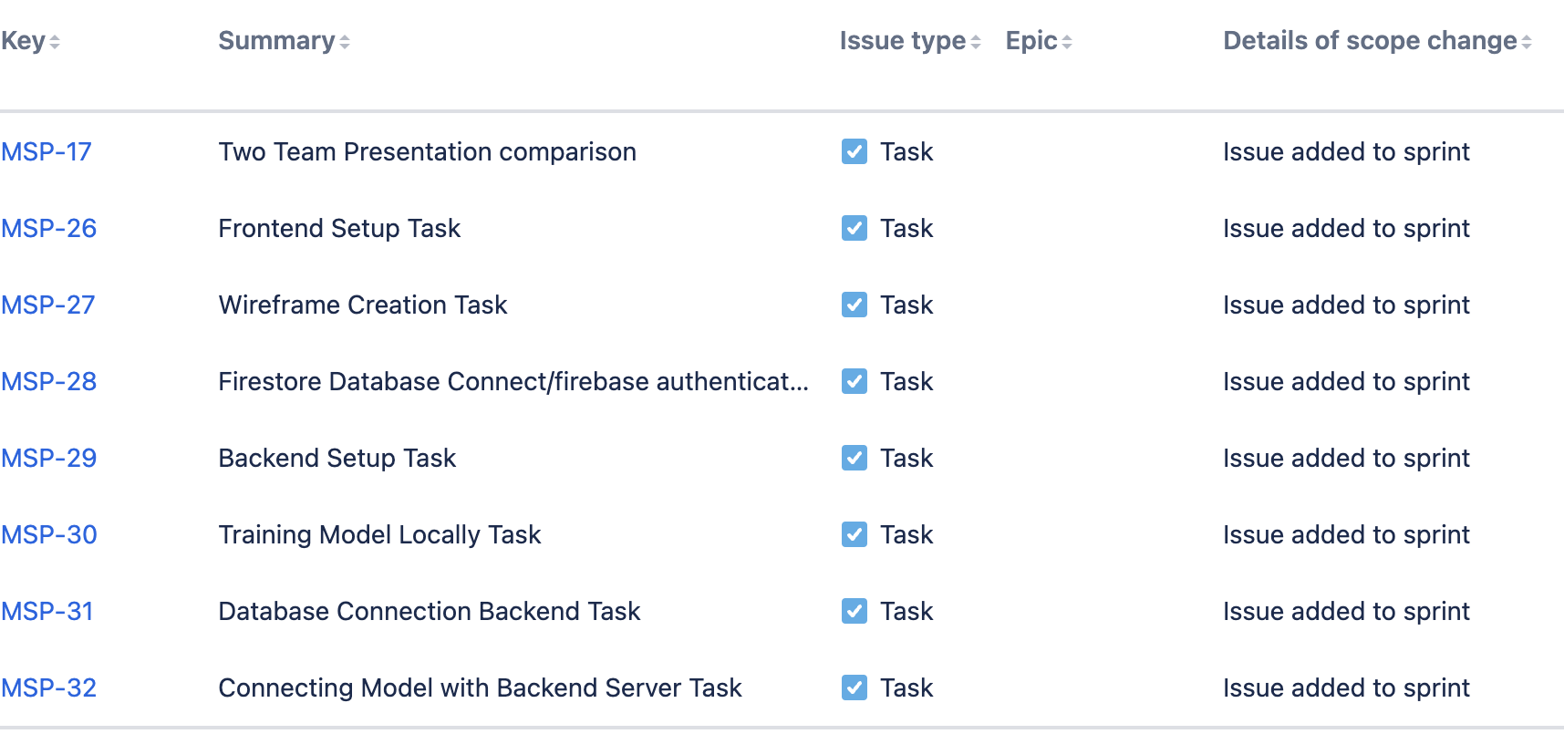
Stories Completed – Sprint 2
MoodSphere

Slide 41
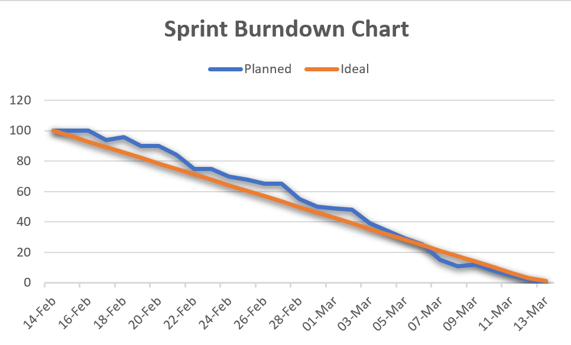
MoodSphere

Slide 42
RETROSPECTIVE
MoodSphere

Slide 43
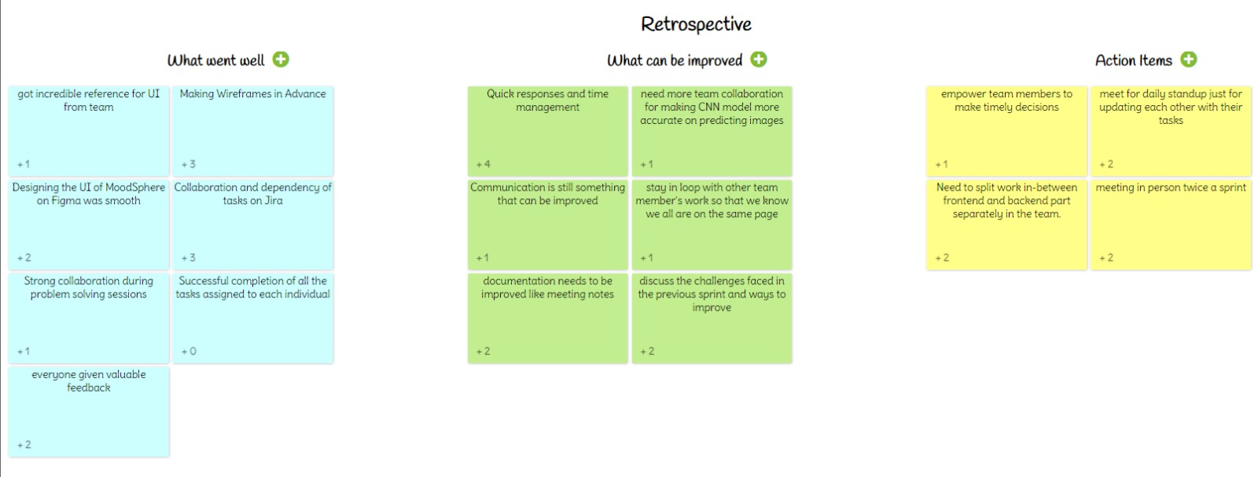
MoodSphere

Slide 44
tEAM WORK AGREEMENT
MoodSphere

Slide 45
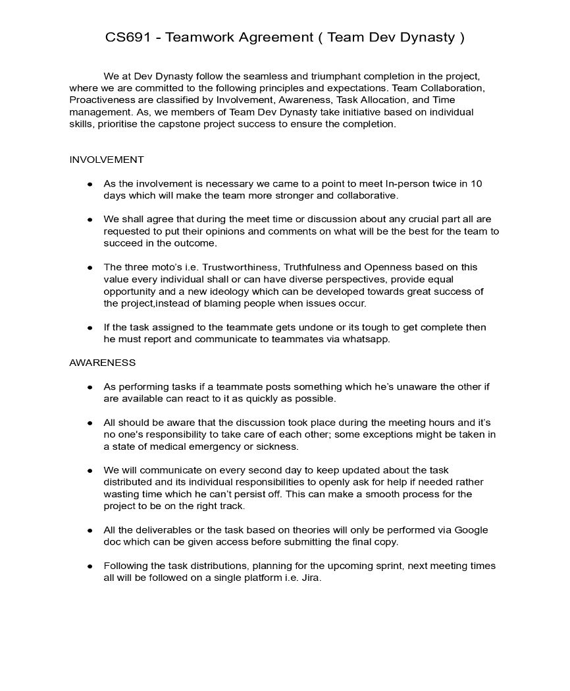
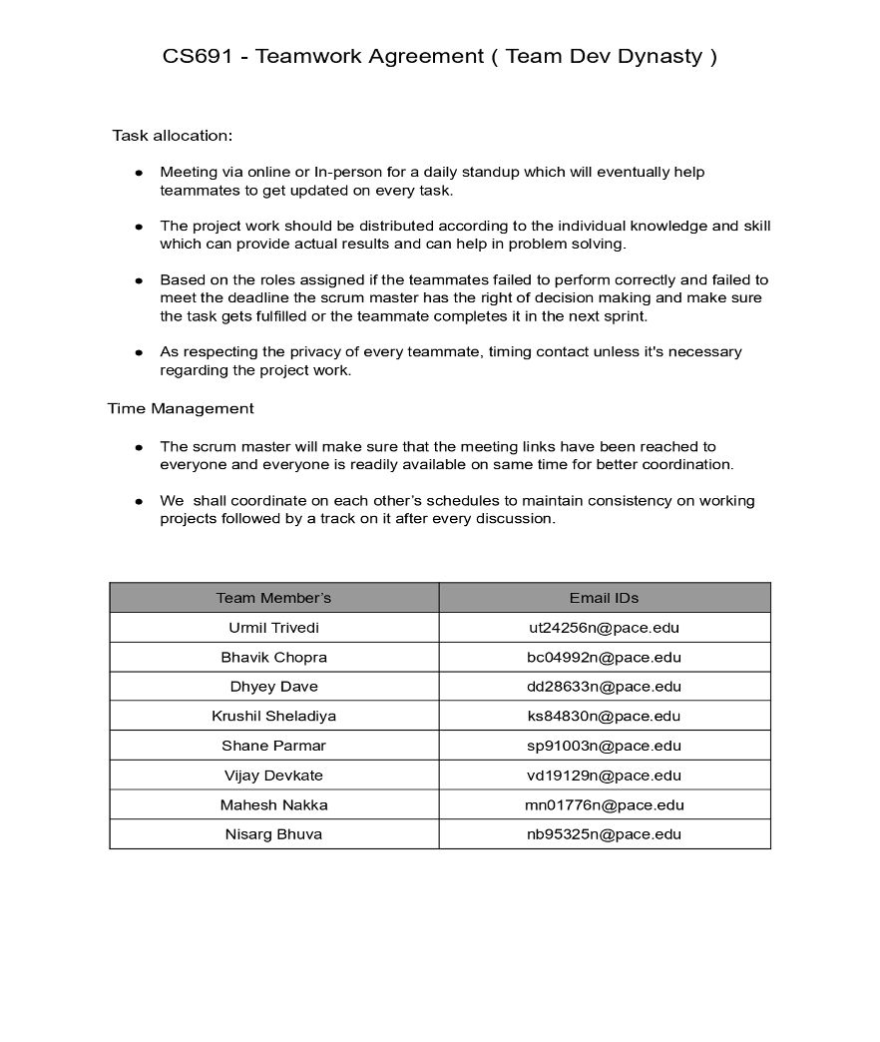

Slide 46

Wiki page link
Home · htmw/2024S-Dev-Dynasty Wiki (github.com)
PROTOTYPE FRONTEND DESIGN EXPLANATION LINK
https://www.youtube.com/watch?v=g2YqTlXZXeQ&feature=youtu.be

Slide 47

Thank you
DevDynasty

